Slide 1

Health Literacy Awareness Workshop
Welcome!
20th March 2018
Arthroplasty Care Practitioners
Kingpower Stadium
Mandy Wardle-McLeish
Chief Executive
Community Health and Learning Foundation

Slide 2
Community Health and Learning Foundation
Who are we?
Our work aims to reduce health inequalities by creating a more health literate Health and Social Care system and more health literate individuals and communities
Notes:
We work top down and bottom up become clearer as we go on

Slide 3

Today…
Definition of Health Literacy
What low Health Literacy feels like
What low Health Literacy looks like
Impact of low Health Literacy on health and wellbeing
How we can help-change things
Shared decision making framework-your views
Notes:
Interactive session

Slide 4
What is Health Literacy?
“The personal characteristics and social resources needed for individuals and communities to access, understand, appraise and use information and services to make decisions about health”
World Health Organisation 2015
Notes:
This definition…
Health Literacy is about people’s ability to function in the health “world” To what extent people are able to take control of their health and wellbeing and make decisions about health. Greater emphasis on self-care and self-management in health at the moment.
That relies on two things:
Personal skills – having skills needed to access, understand and use information and services. By skills we are essentially talking about Language, Literacy, Numeracy (Basic Skills).
Education is one of the most influential determinants of health
People with low basic skills (language, literacy and numeracy) are often the least able to access, understand and use health information and services.
They have the lowest levels of functional Health Literacy.
We know that adults who have low language, literacy and numeracy skills, and their children and families, often suffer the worst health outcomes in society – directly linked to having low skills
2. Social resources/societal responsibility - The way that health information and services are presented to the public.
Generally at the moment, there is a mismatch between people’s skills levels and the way information and services are presented.

Slide 5
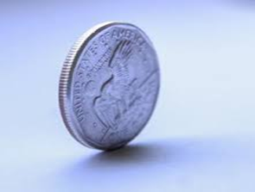
Health Literacy is a two sided coin
Personal/Individual
Health Literacy is about people having the skills, knowledge and confidence they need to be able to make decisions about their health and wellbeing;
People with the lowest levels of language, literacy and numeracy are the people who suffer the poorest health outcomes in society.
Societal
It is also about how well information is provided to people and how well services are set up to ensure that they can be accessed, understood, appraised and used by everyone who needs them.
To improve Health Literacy we need to…
Work with individuals and communities to ensure their skills are as good as they can be to help them manage their health and wellbeing;
Ensure the information and services we are offering are designed to be able to be accessed by everyone, including and especially people with low skills.
Notes:
In the context of the health context and challenges described earlier – this is why Health Literacy is so important

Slide 6
Types of Health Literacy
Conceptual thinking about Health Literacy has developed in the last decade. Three types or levels of Health Literacy have been put forward for consideration:
Functional
Interactive
Critical
Nutbeam D. The evolving concept of Health Literacy. Social Science and Medicine. 2008 December;67(12):2072-8.

Slide 7
Functional Health Literacy
Having the basic skills needed to function in everyday life and typical healthcare interactions
For example:
the ability to read appointment letters;
understand time;
follow simple medicine instructions.
Notes:
The most basic level at which people deemed competent to manage their own health.
Encompasses basic skills in language, literacy and numeracy which have a huge impact on functional Health Literacy

Slide 8
Higher levels of Health Literacy
Interactive Health literacy
Ability to interpret and balance information from different sources as part of decision-making process. Confidence and motivation to seek out information and make decisions
Critical Health literacy
Extension of interactive; includes ability to appraise information critically and make challenges. Understanding of the links between health outcomes and broader social, cultural and economic factors
Notes:
Interactive
Self care
Independent prevention
Knowing what information to trust
Being able to help others manage their health e.g. family members
Shared decision making
e.g. leaving hospital – assessing risk – being involved
Critical
Challenging treatment routes
Interacting with the system/shaping/having an input

Slide 9

What does low Health Literacy feel like?
A practical exercise
Image reproduced with kind permission from wpclipart.com
Notes:
People with low Health Literacy have the worst health outcomes – low Language, Literacy and Numeracy skills are a massive contributor to that
More illness
More years of ill health
More likely to suffer from co-morbidities (several conditions at the same time)
More likely to die younger from preventable illness
What does having low Health Literacy feel like?
DOGS
WRITING – ADDRESS

Slide 10
Defining health literacy
Health literacy is the possession of literacy skills (reading, writing and numeracy) and the ability to perform the knowledge-based literacy tasks (acquiring, understanding and using information) that are required to make health related decisions in a variety of different situations
Health literacy describes an observable set of skills that will vary from individual to individual.
Heath literacy can be considered as a clinical risk, or personal asset
Health literacy describes the cognitive and social skills which determine the motivation and ability of individuals to gain access to, understand and use information in ways which promote and maintain health*
*Nutbeam D. Health Promotion Glossary (1998) Health Promotion International, 13(4): 349-364. (also - WHO/HPR/HEP/98.1)

Slide 11
People move between categories of health literacy
Functional, interactive and critical health literacy are not static constructs
Moving between categories of health literacy progressively indicates greater autonomy in decision-making, and personal empowerment.
Progression between categories is not only dependent upon skills development (reading, writing, numeracy), but also exposure to different forms of information (content and media).
It is also dependent upon a person’s confidence to respond to health communications – described as self-efficacy.
Both moderated by the context in which communication occurs
©Community Health and Learning Foundation 2012 with acknowledgement to D Nutbeam-Univeristy of Sydney

Slide 12
What does low Health Literacy look like?
Image reproduced with kind permission from wpclipart.com
Notes:
Examples of how limited health literacy might impact on health…

Slide 13
How big is the problem?
43% of adults (18-65) do not have adequate literacy skills to routinely understand health information.
61% of adults (18-65) do not have adequate numeracy skills to routinely understand health information.
Rowlands, G. et al (2015)
Notes:
The majority are in the 11-14 year old reading age group – Literacy
The majority have the numeracy capabilities of a nine year old

Slide 14
NQF level | Key stage equivalent | At this LITERACY level an adult understands
Entry level 1 | 5-7 years | Short texts with repeated language patterns on familiar topics
Entry level 2 | 7-9 years | Short straightforward texts on familiar topics and from familiar sources
Entry level 3 | 9-11 years | Short straightforward texts on familiar topics accurately and independently Information from everyday sources
Level 1 | 11-14 years | Short straightforward texts of varying length on a variety of topics accurately and Independently
Level 2 | 14-16 years | A range of texts of varying complexity accurately and independently Information of varying length and detail
Skills
Qualification
Framework
Literacy
Population level
Material level
Slide taken from Presentation to the Health Literacy Group UK Seminar ‘Improving health information to promote health literacy’
Gill Rowlands, Professor, University of Newcastle and Aarhus University , March 2015
Notes:
The majority are in the 11-14 year old reading age group – Literacy

Slide 15
Skills
Qualification
Framework
Numeracy
NQF level | Key stage equivalent | At this NUMERACY level an adult understands
Entry level 1 | 5-7 years | Numbers and symbols in a simple format
Entry level 2 | 7-9 years | Numbers, symbols, simple diagrams and charts in a simple format
Entry level 3 | 9-11 years | Numbers, symbols, diagrams and charts used for different purposes and in different ways
Level 1 | 11-14 years | Straightforward mathematical information, can independently select relevant information
Level 2 | 14-16 years | Mathematical information used for different purposes, can independently select and compare relevant information from a variety of sources
Population level
Material level
Slide taken from Presentation to the Health Literacy Group UK Seminar ‘Improving health information to promote health literacy’
Gill Rowlands, Professor, University of Newcastle and Aarhus University , March 2015
Notes:
The majority have the numeracy capabilities of a nine year old

Slide 16
Who is more likely to have low Health Literacy?
People living with socio-economic disadvantage
People with low educational attainment
Older people
People who have a long term health condition
People with a disability
People with a sensory impairment
People with low information and technology skills
Notes:
Socio economic: low income, unemployment, poor housing, chaotic families
Low educational attainment: often leads to low income, unemployment, basic inability to access and understand health information
Older age: internet, more complex needs, multiple conditions, lack of technical knowledge, less access/mobility
Long term health conditions: introduction of new terminology, anxiety etc
Being disabled: more likely to be unemployed, living with deprivation, low education
Having a sensory impairment: less easy to access information, as disabled
Low information/technology skills: reduced access to systems, services, information

Slide 17
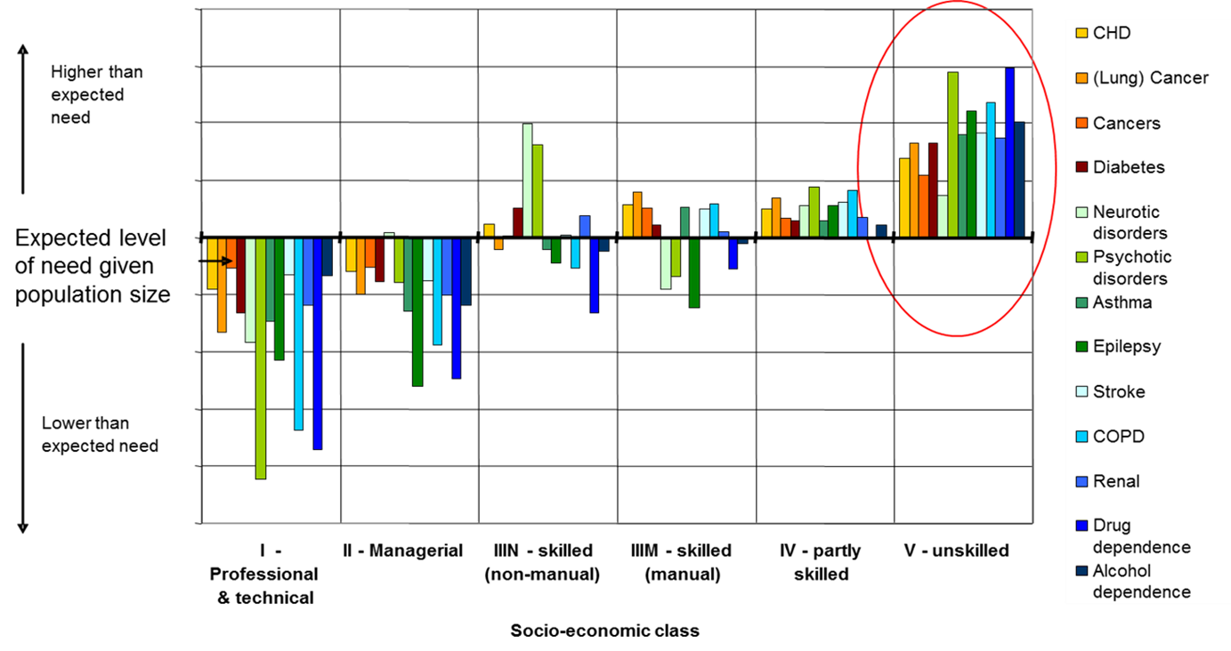
Health conditions by socio-economic class
Notes:
Aware this is a detailed slide and if you want to look at the details for different diseases/conditions later that’s fine
The reason for sharing this with you is because it is a clear image of the link between socio- economic factors and levels of disease in a population .
The horizontal line across the middle is the expected level of need in a population depending on its size.
So what this picture shows is how that level of need ,maps to socioeconomic class.
So on the left classes 1 and 2 have lower then expected levels of need across conditions, this then contrasts with a higher then expected level of need most notably in socioeconomic class 5 unskilled across a range of illness and conditions

Slide 18

The impact of Health Literacy needs on health
Oncology
Paediatrics
Pathology
Podiatry
Psychiatry
Radiology
Rehabilitation
Pharmacy
Gynaecology
Image reproduced with kind permission from wpclipart.com
Prosthesis
Physiotherapy
Urology
Notes:
This is an example of how having low literacy skills can impact on health outcomes…
Peter went to see his GP because he was having breathing difficulties. Because he had been a smoker, and because of his age, she thought it would be wise to send him for a chest X Ray. She filled out the form for the hospital and told him to take it to the X Ray department whenever he had a moment, and she told him she would see him again in a month’s time for another appointment where they would discuss the results.
Peter went to the hospital and when he got there he saw a big board with the following signs on…
He couldn’t see a sign showing where the X Ray Department was, and because he didn’t want to appear foolish and didn’t feel very confident, he decided to go home again.
At his next appointment when he saw his GP, she explained that there were no test results on her computer and Peter told her what had happened at the hospital.
Ask: Does anyone know which department he needed? (radiology)
Emphasise: The length of the words, very difficult for people with skills needs
Point out: This put his route to a diagnosis back by a month at least – cancer – early diagnosis is key

Slide 19

Dr House - asthma inhaler

Slide 20
The impact of low Health Literacy: illness
People with lower health literacy :
Have higher mortality (older people)¹
Have more difficulty managing medication¹
Have a higher prevalence of long-term conditions (LTCs)²
LTCs more likely to be limiting²
Are less likely to engage with disease prevention e.g. cancer screening, immunisation¹
Berkman ND, Sheridan SL, Donahue KE, Halpern DJ, Viera A, Crotty K, et al.
Health literacy interventions and outcomes: An updated systematic review.
Rockville, MD: Agency for Healthcare Research and Quality., 2011 Contract No.: 11-E006.
2. HLS-EU Consortium: Comparative report of health literacy in eight EU member states.
The European Health Literacy Survey (HLS-EU). 2012
Slide taken from Presentation to the Health Literacy Group UK Seminar ‘Improving health information to promote
health literacy’ - Gill Rowlands, Professor, University of Newcastle and Aarhus University , March 2015

Slide 21
Low Health Literacy and medicines
Information leaflets difficult to read, often discarded
Medication instructions - too much text, writing too small
Dosage - frequency not understood
Difficulties buying over the counter medicines
“I don’t know what I’m buying normally, do you know if it’s got Calpol on it, then I’m like that ‘That’s Calpol, that’s fine’…. but then if it’s Cal.. is it Calbrufen? I’m not allowed that, because I’ve got asthma so (son)’s not allowed that…..So you have to watch the colours of the packets and stuff … to tell the difference”
Notes:
Why?
From Scottish research
21

Slide 22
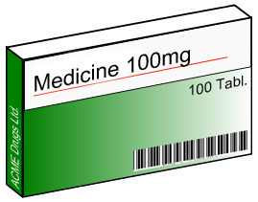
Low Health Literacy and Medicines
What does this mean?
“One to be taken every 8 hours”
53%: every 8 hours for 2 doses only
“Avoid alcoholic drink”
61%: no alcohol
39%: drink a little
Notes:
Dr Theo Raynor – University of Leeds Research
One to be taken every 8 hours – only took them during the time they were awake – assumes you know that every 8 hours fits neatly into 24 and that makes it three times during a day
Problem with the word “avoid”
“Take 2 tablets three times a day”

Slide 23
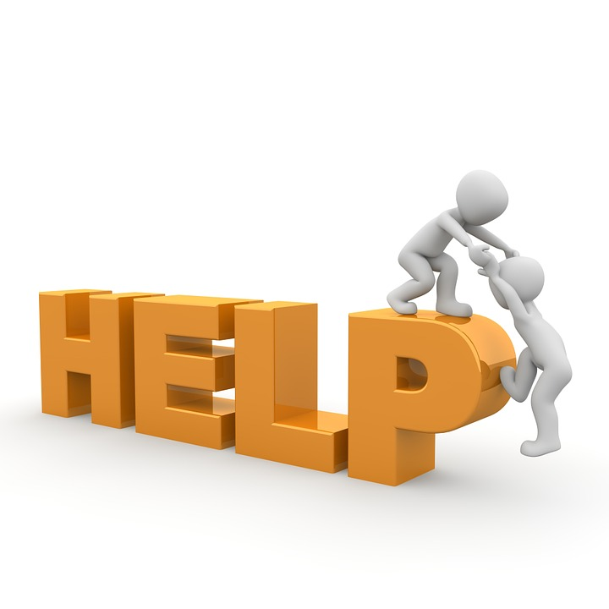
How can we help?

Slide 24
Community Health and Learning Foundation
What do we do?
Develop and deliver Health Literacy courses to individuals and communities to help raise their Health Literacy levels;
Help information providers ensure that their health information is produced in a way that everyone can understand;
Improve the health literacy of the system. Eg Raise awareness of Health Literacy amongst health professionals and practitioners by delivering a range of training.
Notes:
OUR WORK COMES UNDER THREE MAIN STRANDS:
Bottom up – helping people develop and improve skills so they can better manage their health and wellbeing
Top down – making sure information is accessible to all
Making sure that professionals and practitioners on the front line are aware that people they work with may have HL needs so they can develop and deliver their services appropriately
Examples…
Delivery
Skilled for Health, developed with DH and BIS.
Danone – HEY!
Maternity resources
Coventry City Council – Cook and Eat Well
Information
Prostate cancer
Breast cancer
Cervical cancer
Bowel cancer
Pharmaceutical – Diabetes, Cholesterol
HLA training
National – e.g. Stoke City Council, PHEM, HEEM, Derbyshire, Leicestershire
Training in how to deliver Skilled for Health (national HL programme)
Public Health qualifications, L1, L2, L2 Applied
Everyone can do these three things in their own practice…

Slide 25
How can we help?
1. Improving people’s Health Literacy levels
Skills for Life (Language, Literacy and Numeracy)
Health and wellbeing
Skilled
for
Health
Notes:
Improving people’s Health Literacy levels – (bottom up)…
SfH is the national programme that combines Skills for Life with health improvement
It aims to address both the skills needs and health inequalities prevalent within traditionally disadvantaged communities

Slide 26
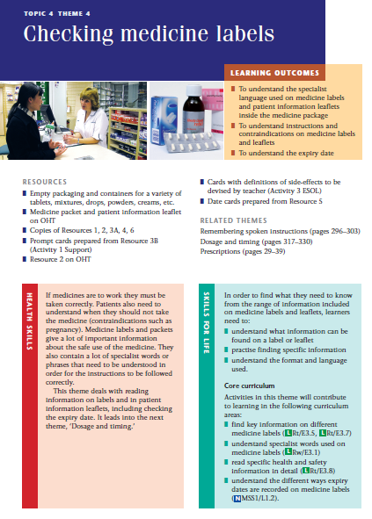
Free resources available from
www.chlfoundation.org.uk/resources
Notes:
This is a sample of the Skilled for Health resources
Health and Wellbeing
Services and Self-Care

Slide 27
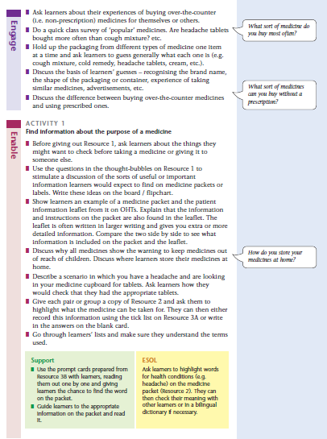
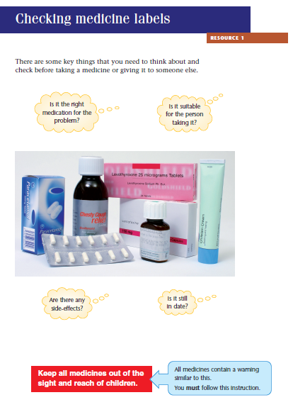

Slide 28
How can we help?
2. Ensuring health information can be understood
Teach back
Chunk and check
SMOG – Simple Measure of Gobbledygook;
Drivel Defence
Creating health information that works
User testing
Notes:
Ensuring Health Information can be understood – Top Down
Range of strategies that people can use to help ensure the information they provide is being understood
Going to look at Teach Back and Chunk and Check in detail first

Slide 29
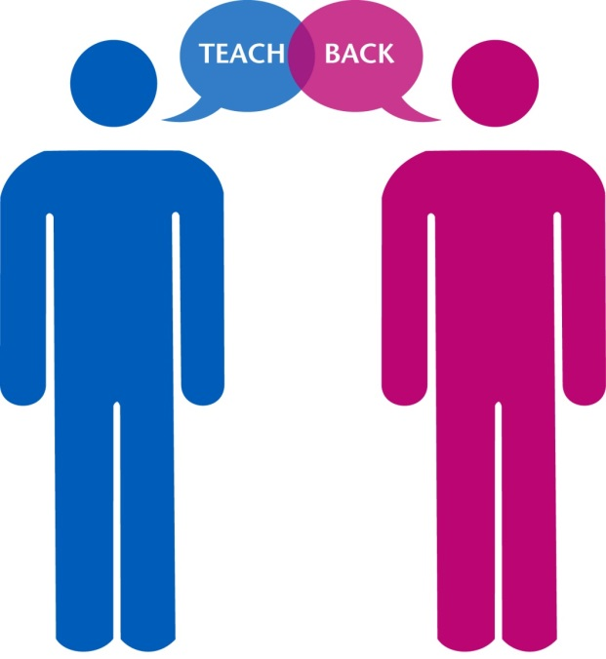
Teach-back
What is it?
A way to make sure you—the health care provider—explained information clearly; it is not a test or quiz of patients;
Asking a patient (or family member) to explain—in their own words—what they need to know or do, in a caring way;
A way to check for understanding and, if needed, re-explain and check again;
A research-based health literacy intervention that promotes adherence, quality, and patient safety.
Notes:
Regardless of a patient’s health literacy level staff must ensure that people understand the information they are being given.
This technique asks patients to state in their own words what has been discussed and what they need to know or do about their current condition/issue. This is a way to confirm that you have explained things in a manner your patients/clients understand. The show me method is related and is used when you are asking people to undertake a physical practice i.e. Applying a cream or giving an injection.
Teach back is appropriate for use with all patient contact and can help:
Improve understanding and adherence
Decrease call backs and cancelled appointments
Improve patient satisfaction and outcomes
Roughly 50% of information provided to patients is forgotten and the 50% that is remembered nearly half of that is incorrect/misunderstood

Slide 30
Using Teach-back
I would like to check that I have explained things properly, would you mind telling me what it is we have discussed and what we have agreed you will do?
Can you tell me how you are going to explain things to your family when you get home tonight?
I want to make sure you have understood, can you tell me what I’ve asked you to do?
Have you understood everything we have discussed?
Notes:
The emphasis is on whether I have explained it properly NOT whether you have understood it. Responsibility is with ME
If you don’t understand, it’s because I haven’t explained it in the right way

Slide 31
4 steps
Clinicians must accept the burden of communication - “I have covered a lot of information today and I want to make sure I did a good job of explaining this.”
The communication should focus on a specific behaviour - “Can you tell me when and how you will take this medicine?”
The patient should be reassessed - and instructions should be explained again in a different manner as needed
Clinicians should continue to explain - until both they and the patient agree that the information has been understood.

Slide 32

Chunk and check
Notes:
This approach can be used in conjunction with teach back, you break down the information that you are giving into small sections/chunks and after each chunk you check for understanding before moving on.
Don’t wait until the end of a potentially long discussion where you are providing lots of information to check for understanding.
DO THE TEACH BACK ACTIVITY – IF HAVE TIME

Slide 33
How can we help?
2. Ensuring health information can be understood
Teach back
Chunk and check
SMOG – Simple Measure of Gobbledygook;
Drivel Defence
Creating health information that works
User testing
Notes:
The SMOG grade is a measure of readability that estimates the years of education needed to understand a piece of writing. SMOG is the acronym derived from Simple Measure of Gobbledygook. It is widely used, particularly for checking health messages.
http://www.niace.org.uk/misc/SMOG-calculator/smogcalc.php#userguide
Drivel Defence - A software package that will help you to check the use of plain English in reports, letters and websites
Creating health information that works - Toolkit looking at how to communicate health information so that people understand it (PIF)
User Testing – test information with your intended audience – we can give you more information on that if people are interested

Slide 34
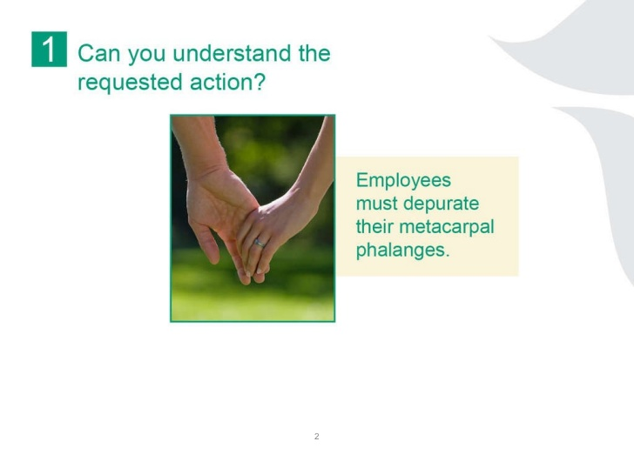

Slide 35
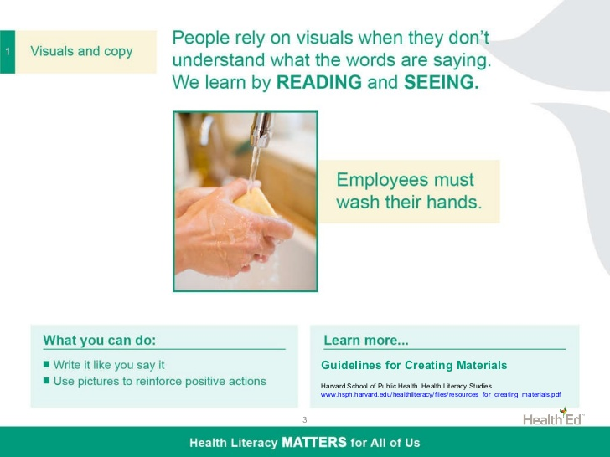

Slide 36
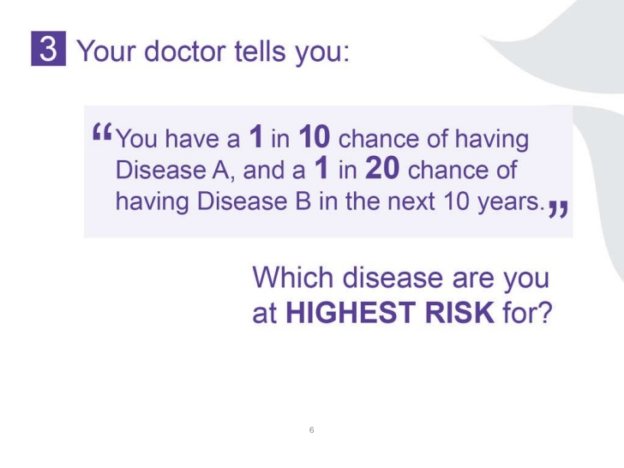

Slide 37
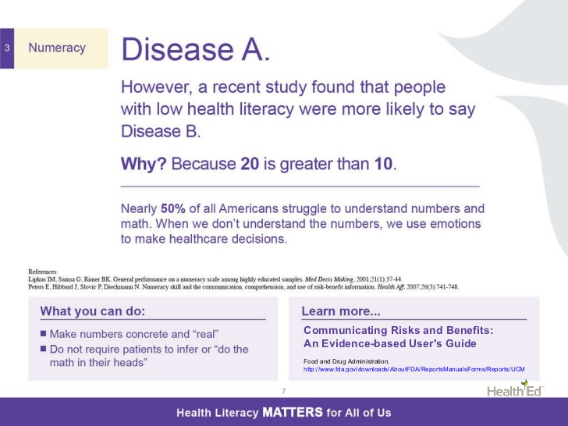
Notes:
Functional numeracy in the UK is considered to be Entry Level 3 (what is expected of an average 9-11 year old). 24% of the population are below this level.
61% of adults (18-65) do not have adequate numeracy skills to routinely understand health information.

Slide 38
What do these mean?
Hypertension
Diet
Modify
Positive/negative
Chronic
Topical
High blood pressure
What you eat
Change
Good/bad result
Long term/on-going
Applied to a particular place in/on the body

Slide 39
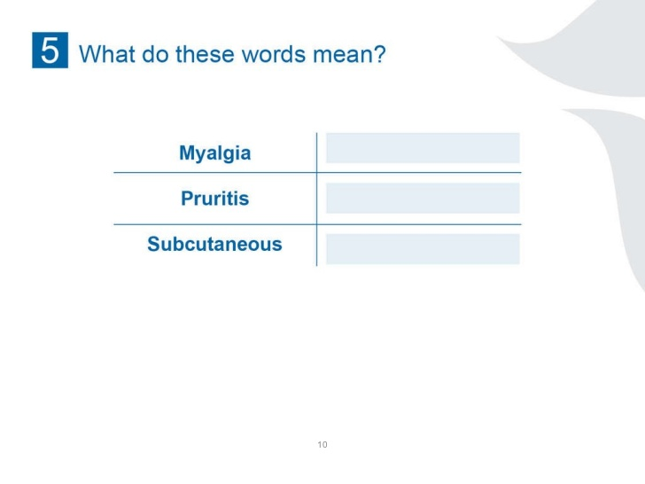

Slide 40
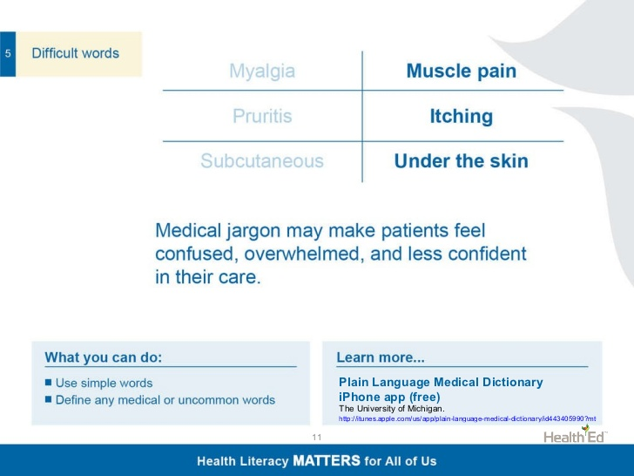

Slide 41
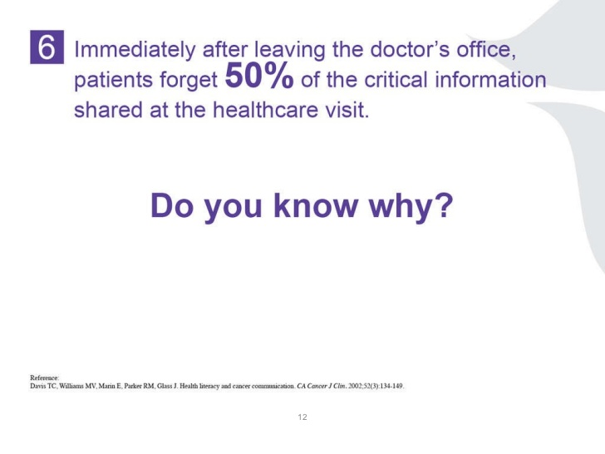

Slide 42
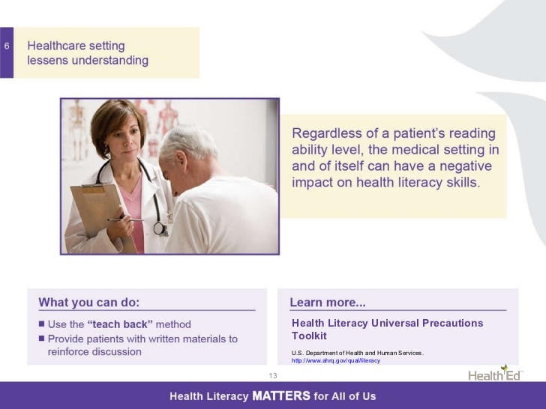

Slide 43
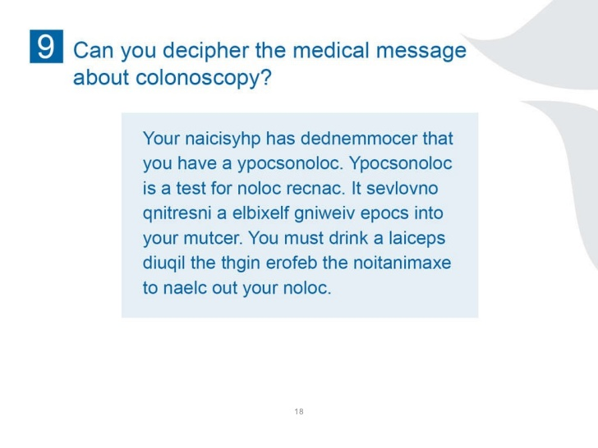

Slide 44
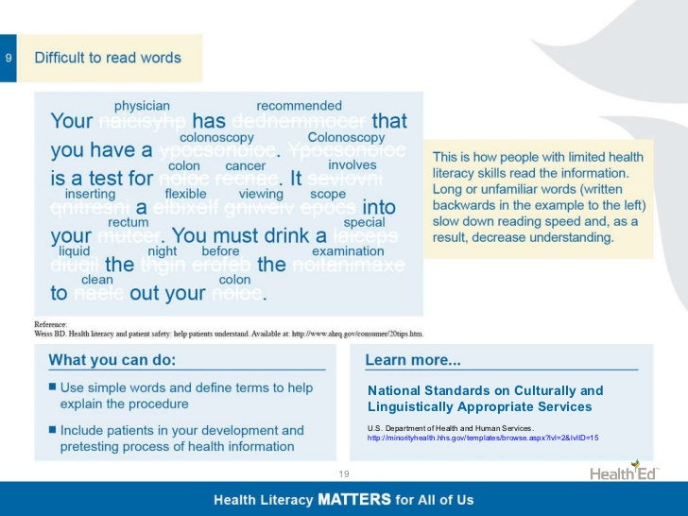

Slide 45
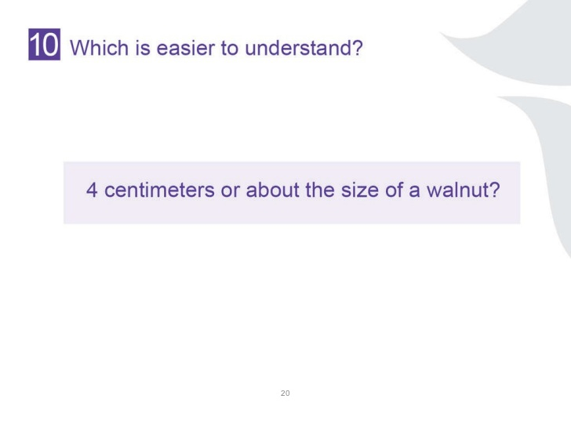

Slide 46
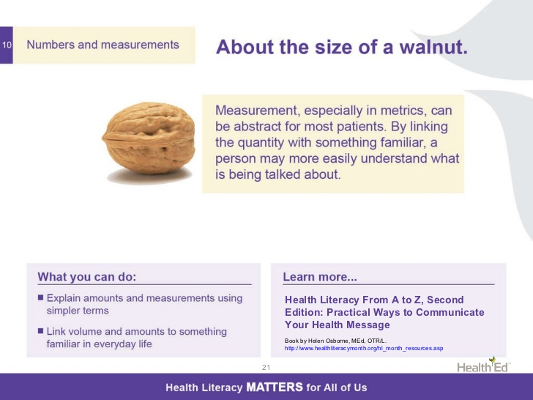

Slide 47

Health Literacy is fundamental to delivering key policies and priorities
Patient–centred care
E.g. informed consent, shared decision making
Self-management/care
Public Health/Health Inequalities
E.g. healthy eating, physical activity messages
Treatment and Adherence
E.g. how to explain symptoms and risks, taking medication
Personal and Public Involvement (PPI)
E.g. responding to service reconfiguration
Image reproduced with kind permission from wpclipart.com
Notes:
We mentioned a number of current priorities and initiatives earlier MECC ,shared decision making etc
In fact, low Health Literacy cuts across all key domains of health

Slide 48
Health literacy matters…
in a health care system where there is a need for more effective prevention,
commitment to patient centred care, and greater than ever dependence on patient self-management of chronic conditions.
There is a strong social gradient in the population, with lower levels of health literacy much more common among the socially and economically disadvantaged.
Those with greatest need are generally least able to respond to the demands of the health care system

Slide 49
Three main areas of influence…
Improving people’s Health Literacy levels (bottom up approach)
Ensuring information and services are accessible to all (top down approach)
Helping the system to become more Health Literate
Notes:
Bottom up – helping people develop and improve skills so they can better manage their health and wellbeing
Top down – making sure information and services are accessible to all.
Helping the system to become more Health Literate - Making sure that professionals and practitioners on the front line are aware that people they work with may have HL needs so they can develop and deliver their services appropriately

Slide 50

Promoting Health Literacy
Disseminating information to colleagues
Health Literacy Awareness Training
Resources and programmes like Skilled for health
Health literate organisations (HLF)
Putting Health Literacy at the heart of approaches which promote and improve health and wellbeing:
  Making Every Contact Count (MECC)
  Person-centred care
  Shared decision making
  Social prescribing
  Patient activation measures

Slide 51

A final word…recommendations from people with low health literacy
Don’t assume that people can read or write;
Use a variety of media to share information;
Oral explanation in simple terms;
Keep forms simple and explain them;
Offer to help without labelling;
Don’t put people on the spot;
Send forms out before appointments.
Image reproduced with kind permission from wpclipart.com
Notes:
Scottish research

Slide 52
Other useful resources
Health Literacy Curated Collection
www.healthliteracy.org.uk
www.chlfoundation.org.uk
www.healthliteracyplace.org.uk (Scotland)

Slide 53
For more information…
Community Health and Learning Foundation
www.chlfoundation.org.uk
01509 768081
Mandy Wardle-McLeish – Chief Executive
mandy.wardle-mcleish@chlfoundation.org.uk
07833121695
Notes:
If you would like further information take a look at our website.
or to make a case to book courses please contact …

Slide 54
Developing a Patient Decision Support Framework
What do you think would be the key elements of an effective health literate, decision support framework?
What would you expect the framework to look like?
In order to put the framework into operation, what practical mechanisms do you think should be in place to help the patient/clinician discussion in this respect?
What would you say were the key barriers to making health literate shared decisions and how would a framework solve these?

