Slide 1
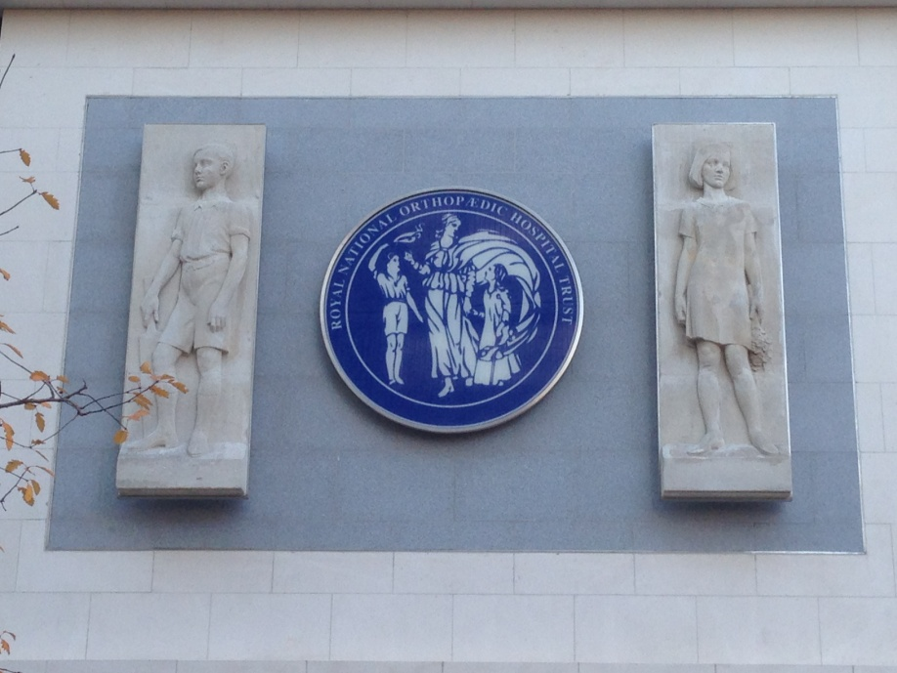
Radiology:
Back to Basics
ACPA 2018
Dr Michael Khoo
Consultant Radiologist, RNOH

Slide 2
Aims
Understand the basics of Radiology
X-rays
  Review areas
Ultrasound
CT
MRI
Nuclear Medicine
Notes:
Physics
Analysis
Advantages vs Disadvantages

Slide 3
Why?
Foundation
Understanding
  Basics
  What you can do on PACS!
Not to scare you!
PS – There is very little metalwork in this talk….

Slide 4
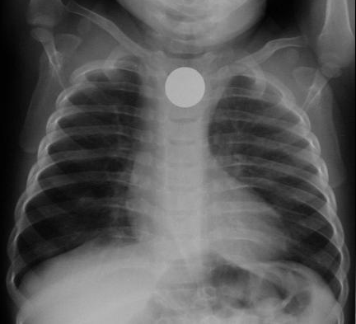
Density
Metal
Bone
Soft tissue/fluid
Fat
Air

Slide 5
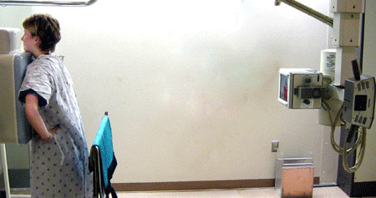
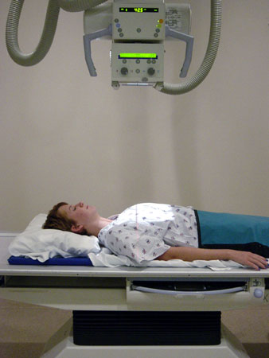
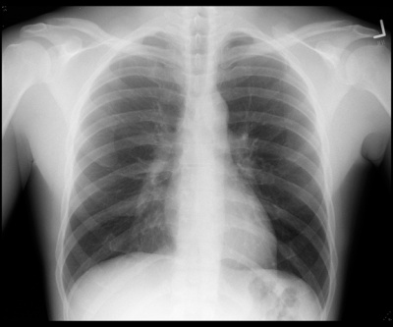
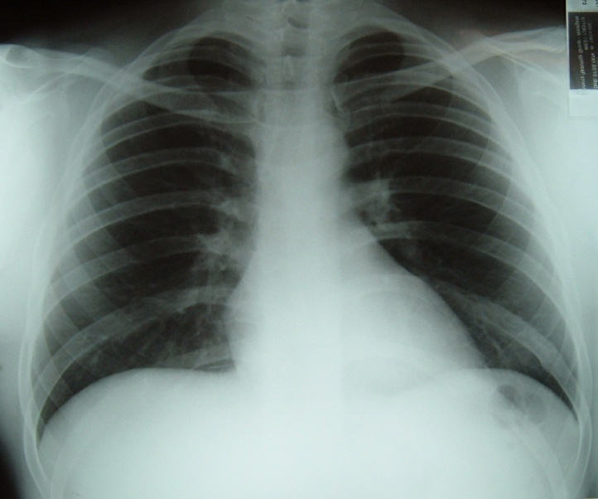
Orientation PA vs AP
A
P
A
P

Slide 6
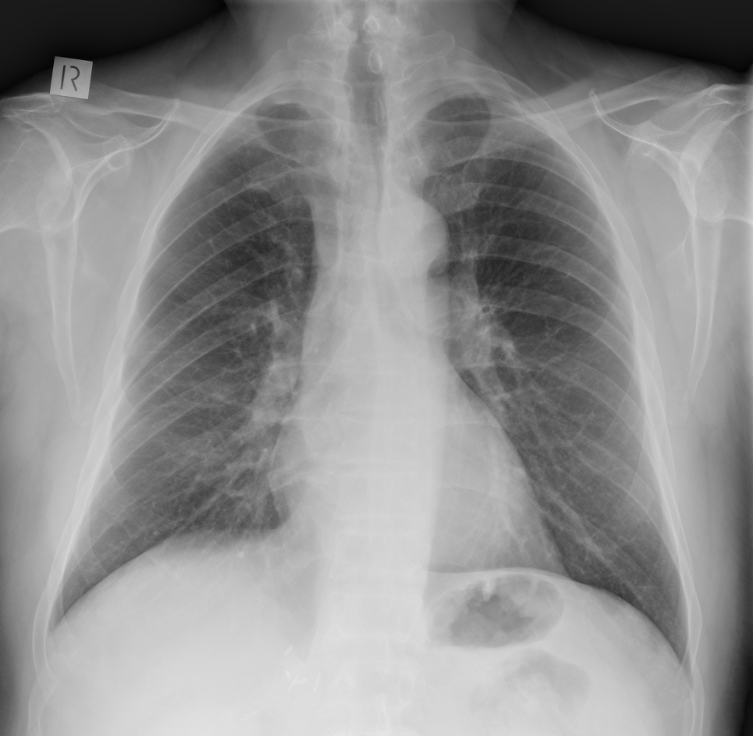
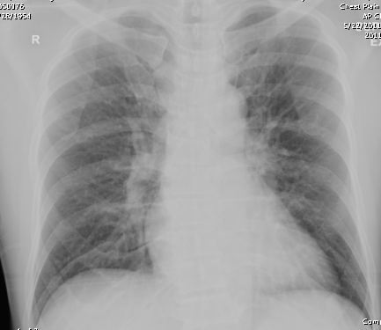
PA Erect
AP Supine

Slide 7
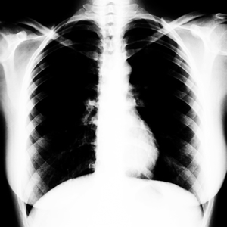
Exposure

Slide 8
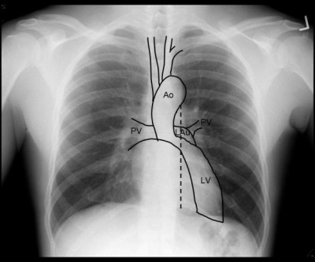
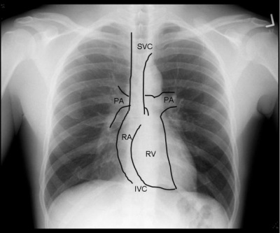
Anatomy
Trachea
Clavicle
Acromion
Glenoid Fossa
Scapula
Post rib
Ant rib
Liver
Stomach

Slide 9
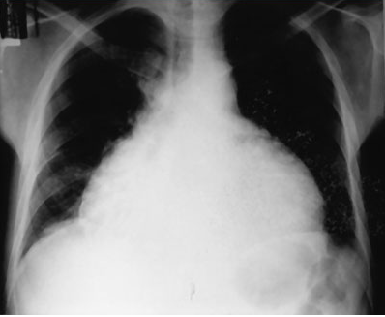
Cardiothoracic ratio
> 0.5 ?

Slide 10
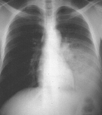
Left Lower Lobe pneumonia

Slide 11
Right Pleural Effusion

Slide 12
Pneumothorax

Slide 13
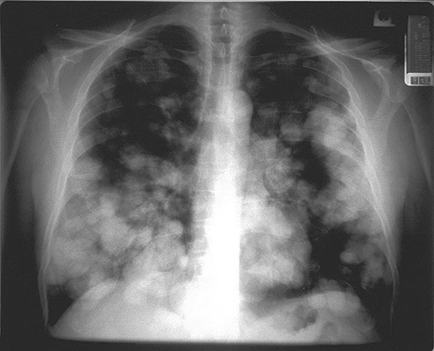
Multiple pulmonary nodules (metastases)

Slide 14
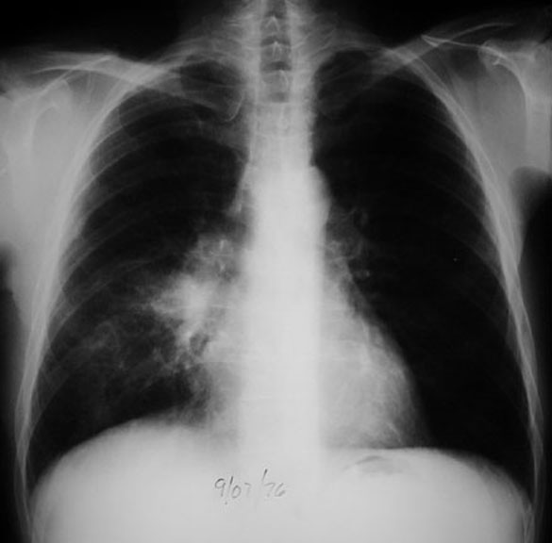
Hila

Slide 15
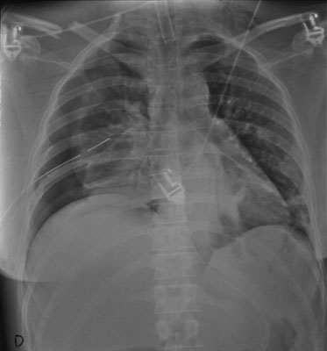
Bones

Slide 16
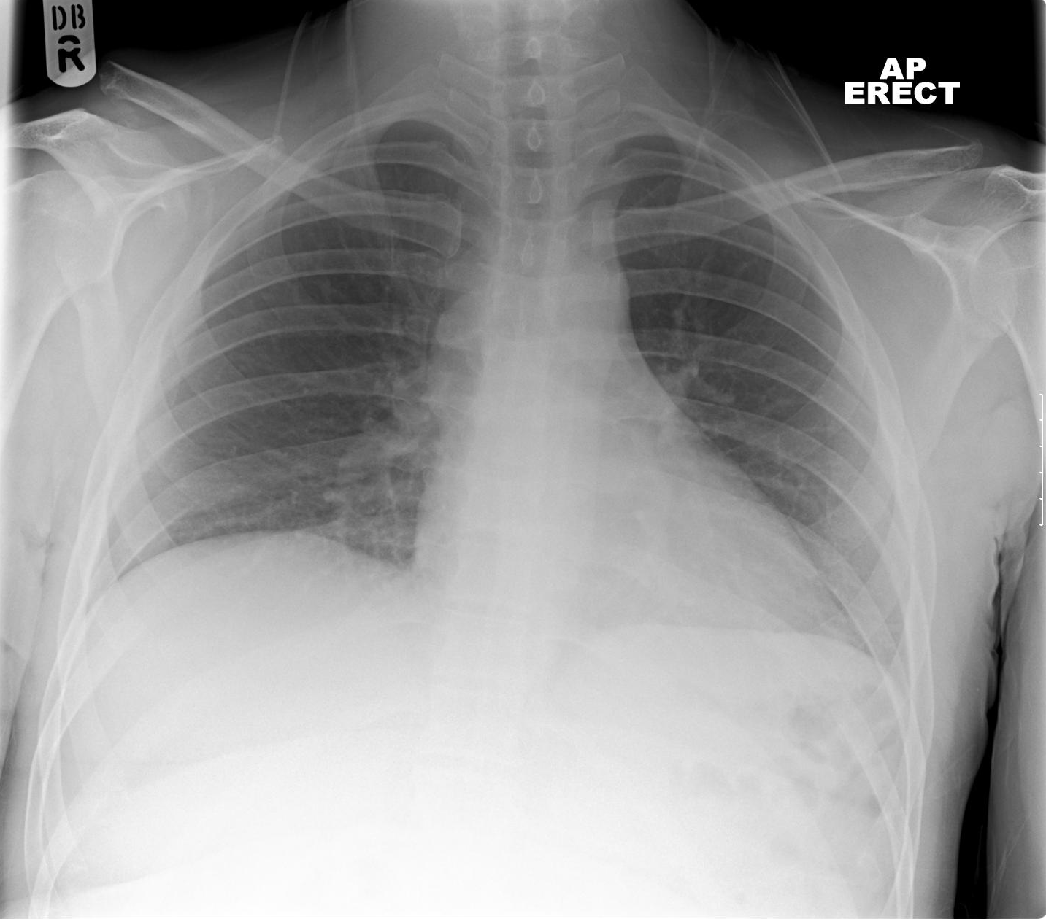

Slide 17
Poorly checked areas

Slide 18
Abnormality: free intra-peritoneal air

Slide 19
General Orthopaedic Principles
2 views
Position relative to anatomy

Slide 20
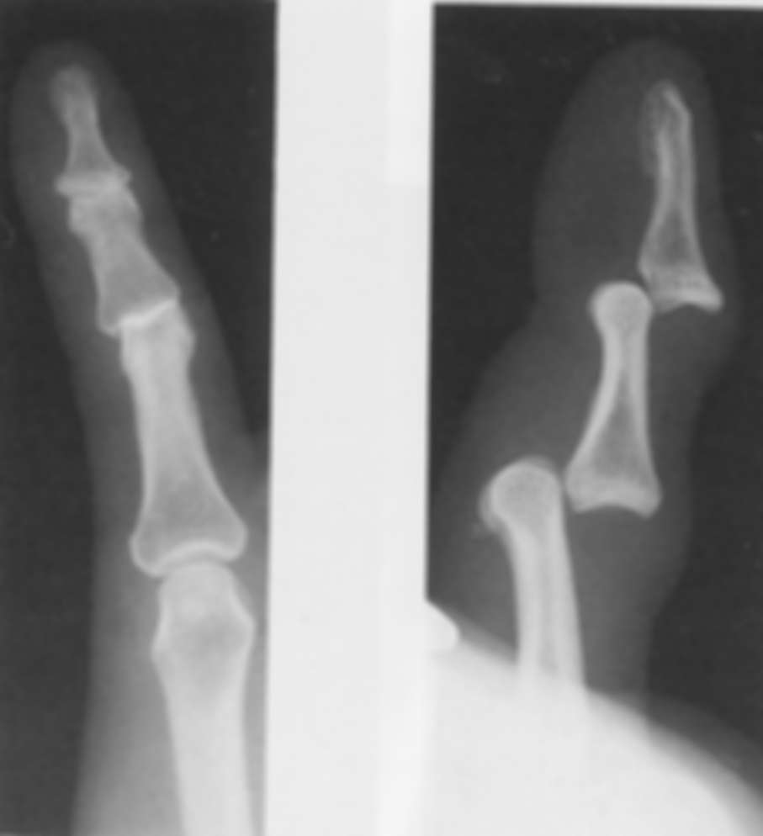
Two Views

Slide 21
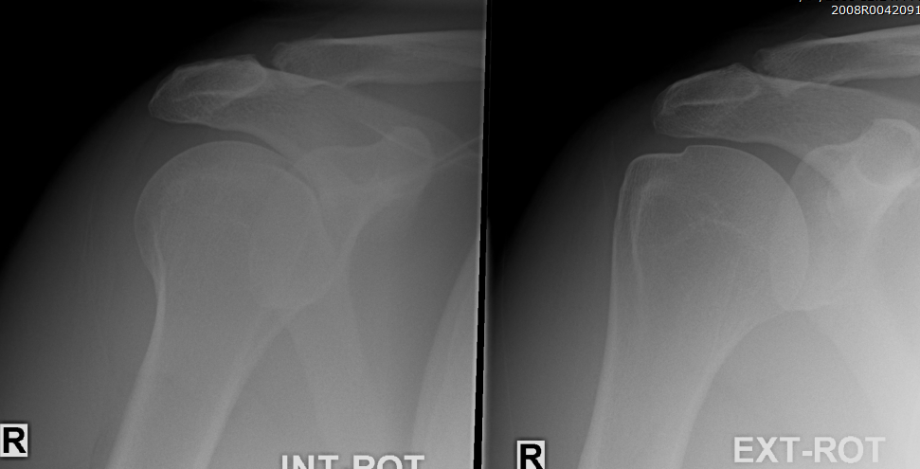
Subject Position

Slide 22
Looking at an x-ray
Identity
2 views or more (projections)
Bone outline
Alignment of joint surfaces and joint
Soft tissues

Slide 23
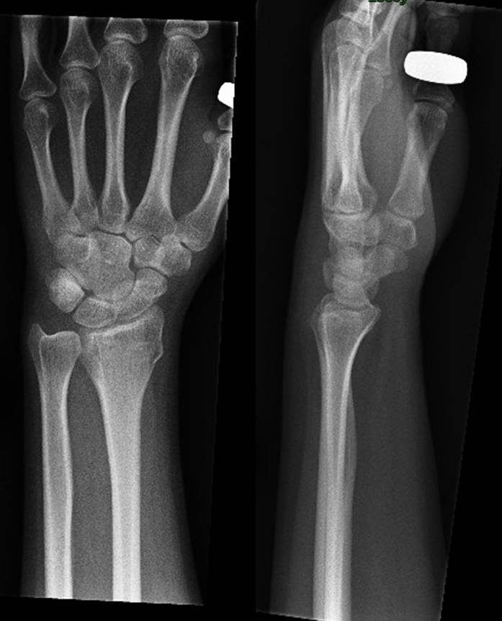
Bone outline

Slide 24
Describing fractures
Location
Open vs. closed
Intra-articular extension
Degree (complete vs. incomplete)
Comminuted/pattern
Displacement, angulation and rotation
Other signs

Slide 25
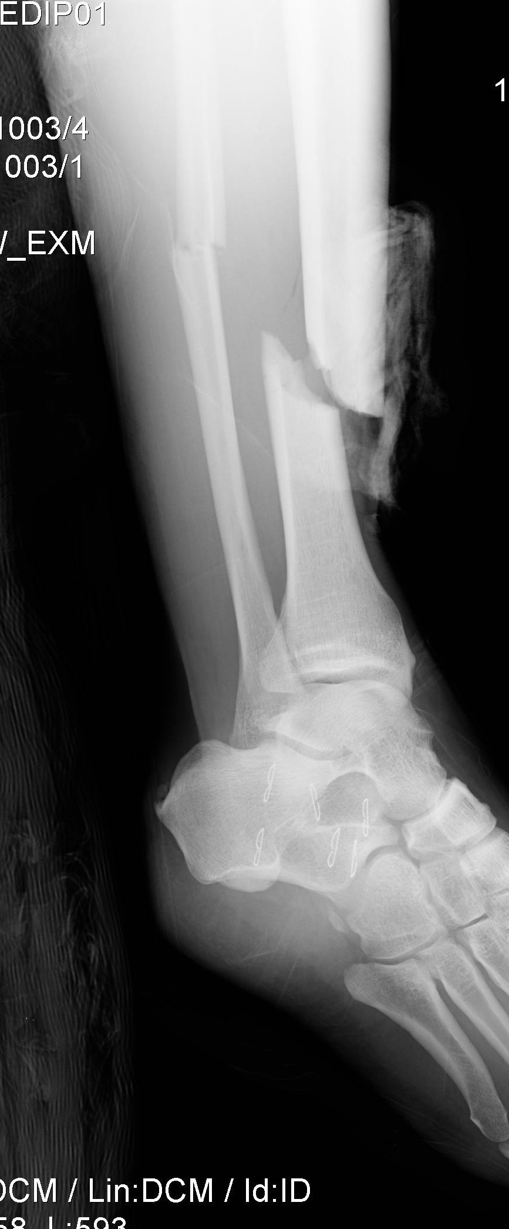
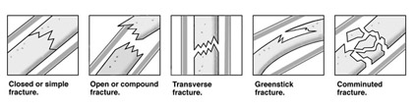
Open vs. Closed
Closed – intact skin
Open – bone penetrates through skin
  aka “compound fracture”
Notes:
Fracture with breach of skin barrier – consider open fracture until proven otherwise.

Slide 26
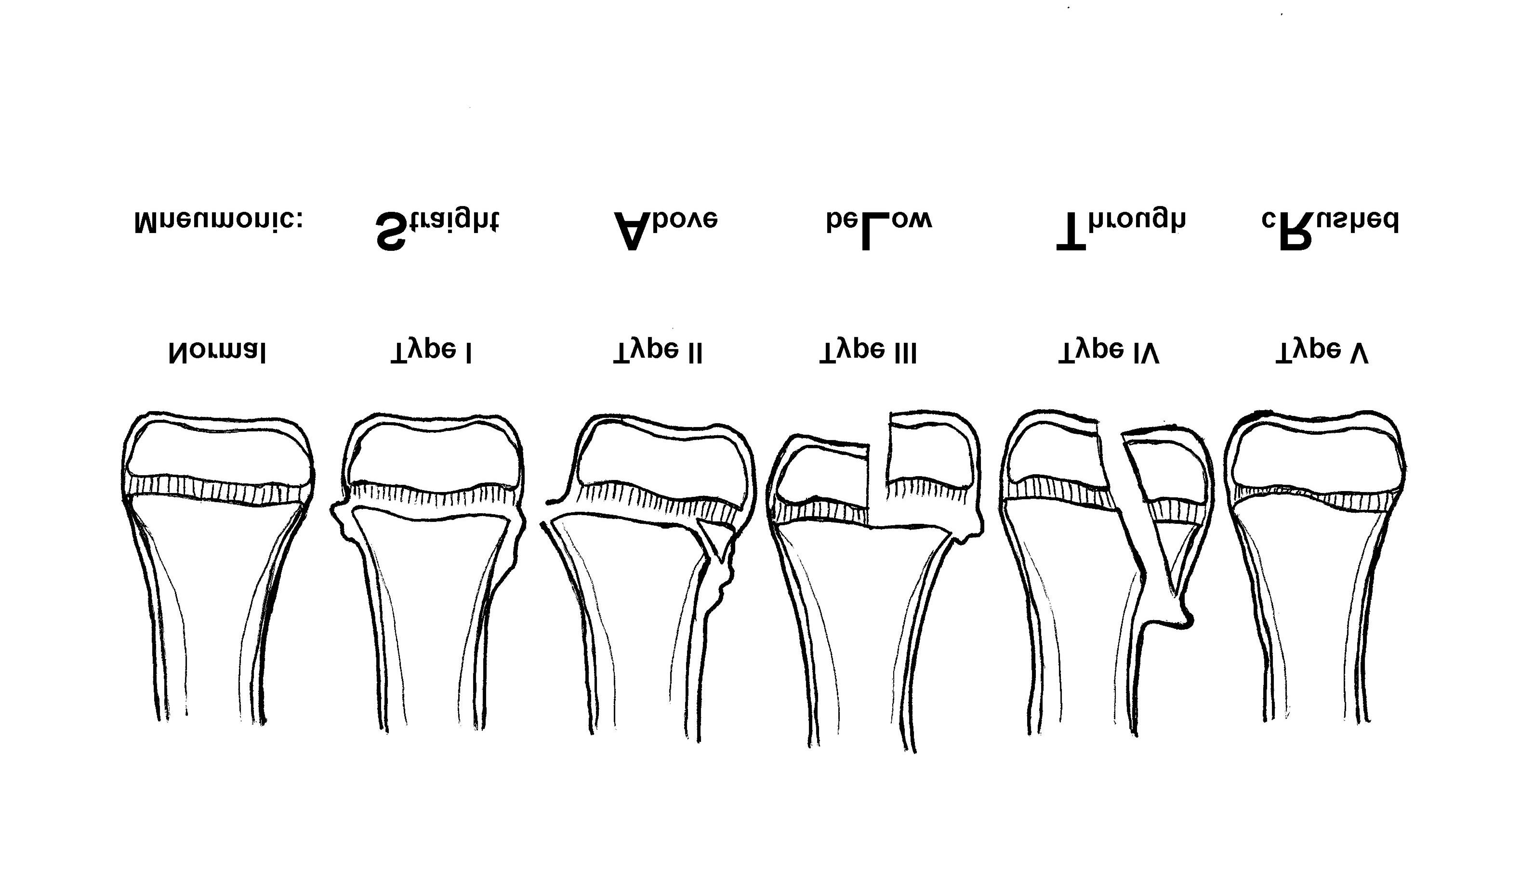
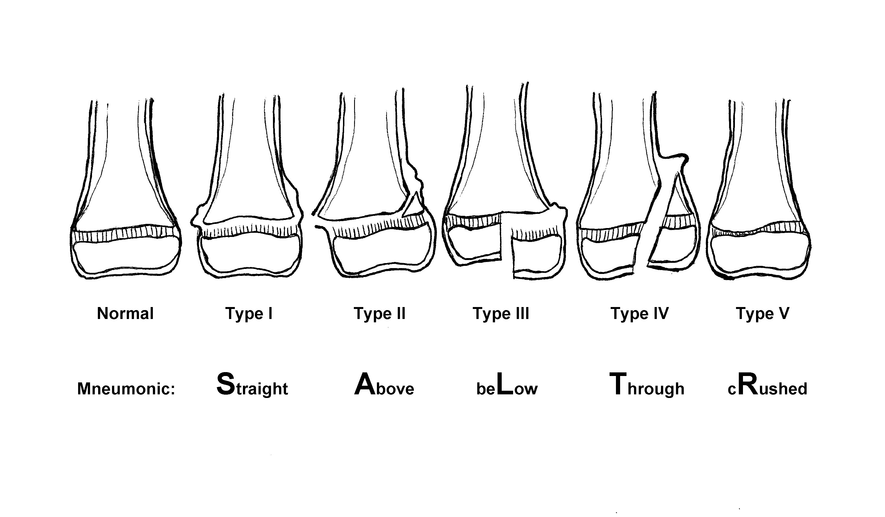
Location
Which bone?
Thirds (long bones)
  Proximal, middle, distal
Anatomic orientation
  E.g. proximal, distal, medial, lateral, anterior, posterior
Anatomic landmarks
  E.g. head, neck, body/shaft, base, condyle
Segment (long bones)
  Epiphysis, physis, metaphysis, diaphysis
Epiphysis
Physis
Metaphysis
Diaphysis (shaft)
Articular Surface

Slide 27
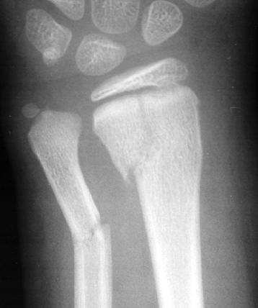
Degree
Complete:
  Entire cortical circumference
  Fragments are completely separated
Incomplete:
  Only one cortex involved
  E.g. greenstick fracture

Slide 28

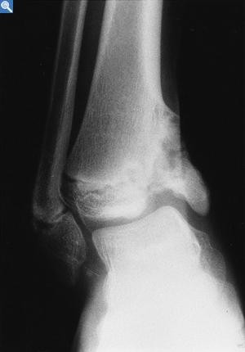
Articular Extension
Intra-articular fractures
Involves the articular surface
Dislocation - loss of joint surface / articular congruity
Fracture-dislocation

Slide 29
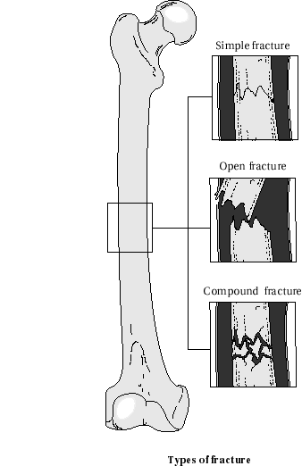
Comminution / Pattern
Simple:
  Transverse
  Oblique
  Spiral
  Linear / longitudinal
Comminuted
Compression / impacted:
  Buckle / torus
Distraction / avulsion

Slide 30
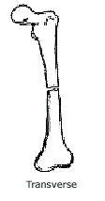

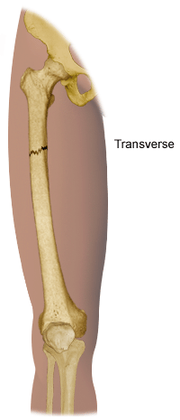
Comminution / Pattern

Slide 31


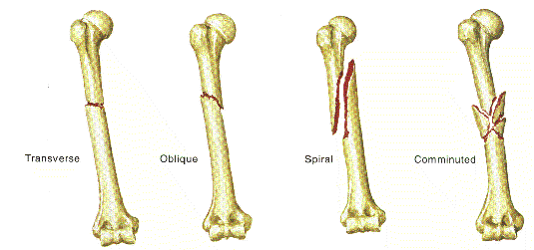
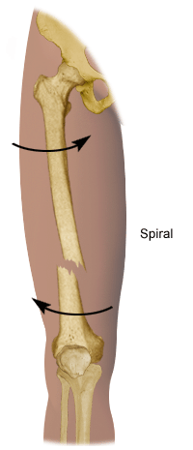
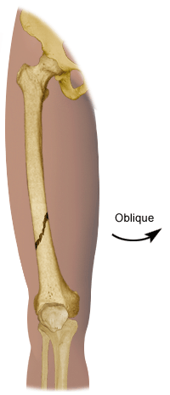
Comminution / Pattern
Oblique
Spiral – oblique in 2+ views

Slide 32
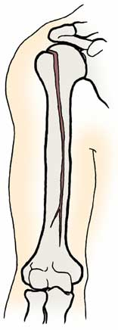
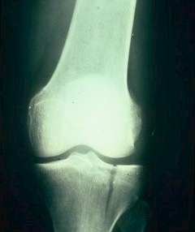
Comminution / Pattern
Linear / longitudinal / split

Slide 33
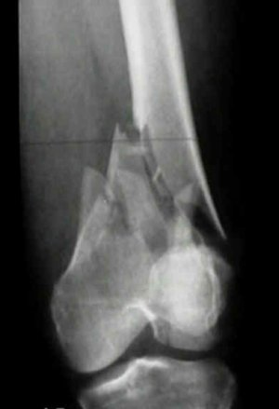
Comminution / Pattern
Comminuted:
  Broken, splintered or crushed into >3 pieces

Slide 34
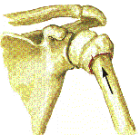
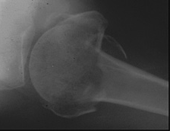
Comminution / Pattern
Impacted

Slide 35
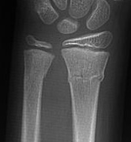
Comminution / Pattern
Buckle / torus
Notes:
Torus – both cortices
Buckle
Greenstick

Slide 36
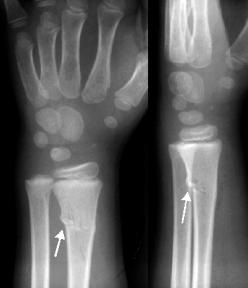
Greenstick fracture

Slide 37
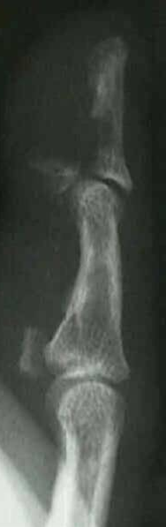
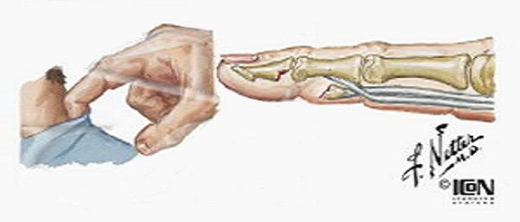
Comminution / Pattern
Avulsion
Distraction

Slide 38
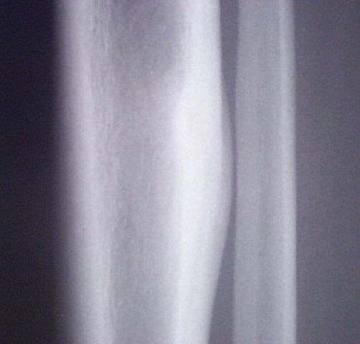
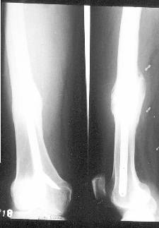
Other signs of fracture
Periosteal Reaction
Callus / Osteosclerosis

Slide 39
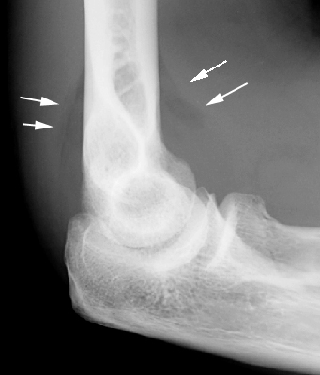
Other signs of fracture
Fat pad sign
aka “sail sign”

Slide 40
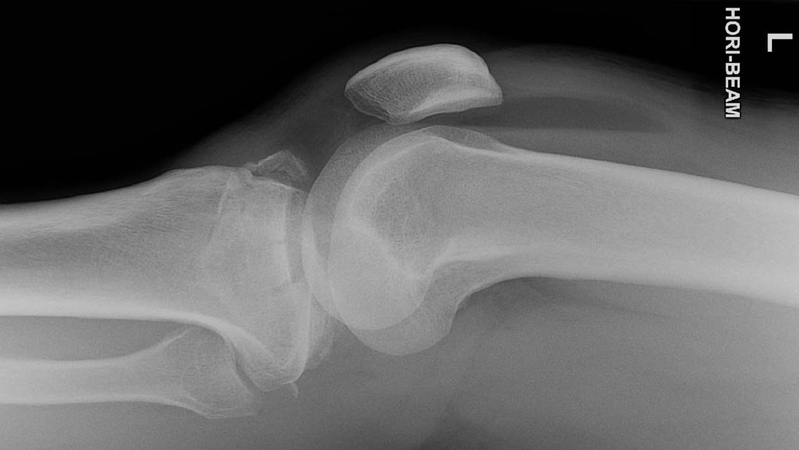
Lipohaemarthrosis = Intra-articular Fracture

Slide 41
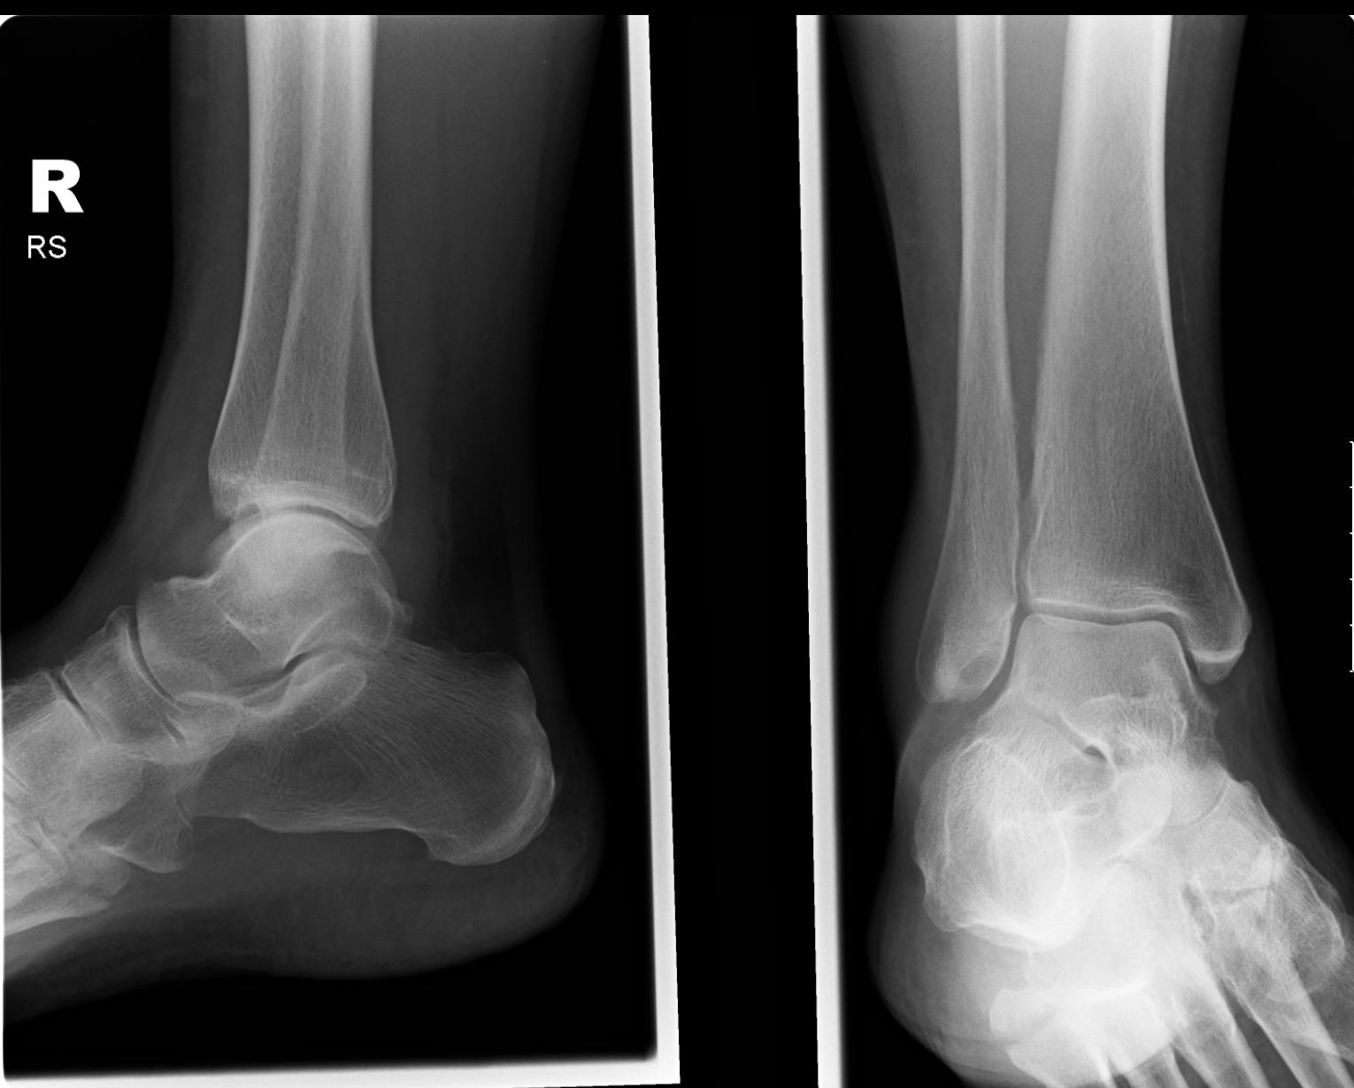
Ankle Plain Films

Slide 42
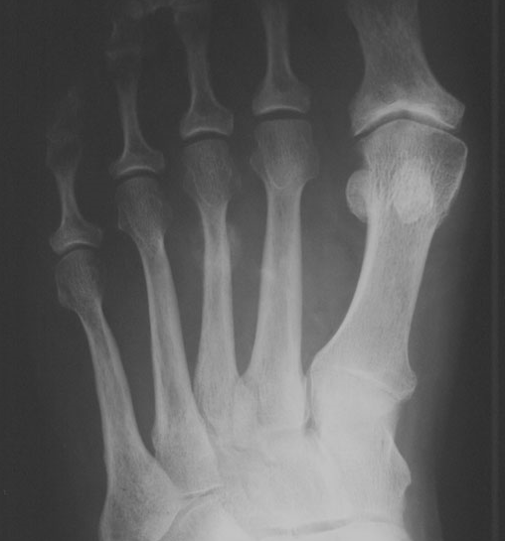
March / Stress Fractures
2nd / 3rd MT
Periosteal reaction
Repeated trauma (runners, soldiers)

Slide 43
Fracture summary
Open vs. closed
Location
Degree (complete vs incomplete)
Articular extension
Comminution / pattern
Displacement, angulation, rotation
Other signs

Slide 44
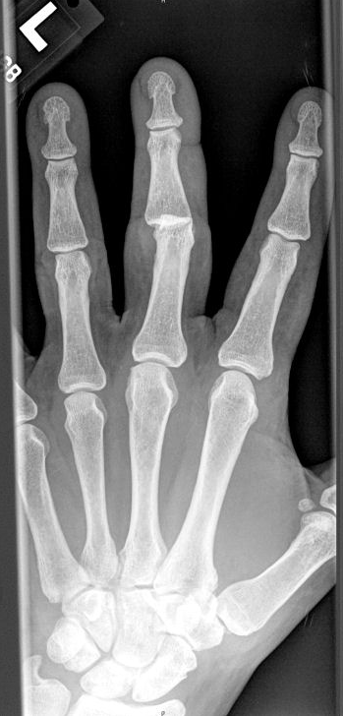
Alignment

Slide 45
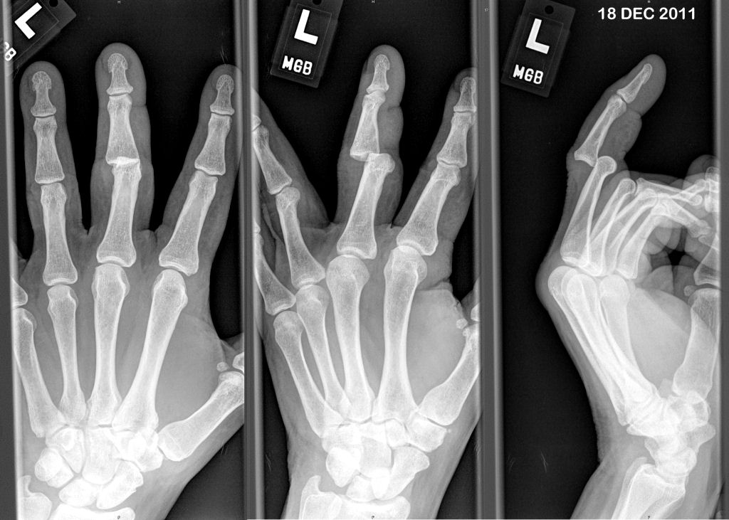
Alignment

Slide 46
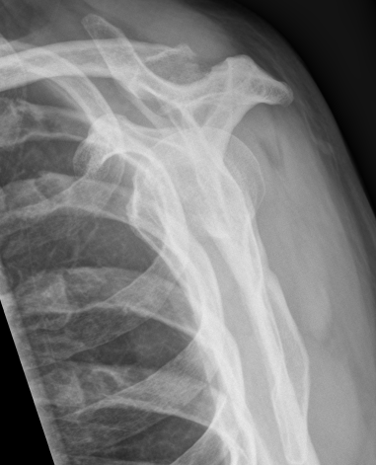

Alignment

Slide 47



Slide 48


Slide 49


Arthritis / Arthropathy

Slide 50


Slide 51


Soft tissue

Slide 52

Soft tissue

Slide 53
Supraspinatus calcification

Slide 54

Notes:
Synovial osteochondromatosis
may occur as a primary disorder or be secondary to cartilage damage from other conditions.
Primary synovial chondromatosis is a benign, predominately monoarticular disease.
It results from synovial membrane proliferation and metaplasia forming multiple cartilaginous nodules that may detach into the joint. As the chondroid fragments are bathed and nourished in the synovial fluid, they can .

Slide 55


Slide 56


Slide 57


Slide 58



Slide 59


Slide 60


Slide 61


Slide 62


Slide 63


Slide 64


Slide 65


Slide 66


Slide 67


Slide 68


Slide 69


Slide 70


Slide 71


Slide 72


Slide 73


Slide 74


Slide 75


Slide 76



Slide 77


