Slide 1
SETTING UP AN ARTHROPLASTY SERVICE

Slide 2
Background
To free up consultant follow-up slots
Improved quality for patients
Easily identifiable cohort of patients

Slide 3
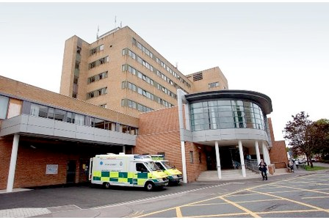
Background
Small district general hospital
7 orthopaedic consultants

Slide 4
How we started
Visited Glasgow
Started with one consultant in 2006 linked with the introduction of enhanced recovery programme
Gradually rolled out to all consultants by 2008
Set up needs

Slide 5
Aims
To improve and maintain the quality and continuity of service provided to outpatients
To increase patient satisfaction
To reduce outpatient waiting times
To ‘free up’ consultant clinic slots
To collect consistent outcome data
To improve patient information
To improve access to follow up
To develop the nursing role

Slide 6
PRESENT
Service continues to grow
September – December 2006:
21 patients
September – December 2012:
342 patients
Backfill achieved in 2009 for 24 hours
Nurse follow up less costly

Slide 7
Present
ACPA
Capacity
Juggling roles

Slide 8
FUTURE
Upper limb arthroplasty follow up
Continuing professional development
? Any follow up at all

Slide 9
Any questions
?
And thank you

