Slide 1
Metal on Metal Hip Arthroplasty Experiences in Liverpool
Cathy Armstrong
Research Physiotherapist
Royal Liverpool University Hospitals Trust

Slide 2
Background
Orthopaedic Hip team consists of 3 consultant orthopaedic surgeons
Research Physiotherapist (Cathy Armstrong)
Specialist Registrar
Hip Fellow
I have been in post since 2002

Slide 3
History of Metal on Metal (M-o-M) Hips Royal Liverpool Hospitals
1998-2002 255 Birmingham Hip Resurfacings implanted
2002- change of surgeon. Due to reports of # NOF with BHR he used the Birmingham head on a Freeman Stem

Slide 4
History of Metal on Metal (M-o-M) Hips Royal Liverpool Hospitals
Birmingham cup and head on a Freeman uncemented stem (Birmingham Hybrid)
2002-2003 implanted
n=203
Due to change of manufacturer the Birmingham Hybrid was no longer implanted after 2003

Slide 5
Metal-on-Metal hip types
2003-2005 Variety of metal on metal implants used e.g..
Pinnacle cup and
SROM stem
Pinnacle cup and
Corail stem
215 implanted

Slide 6
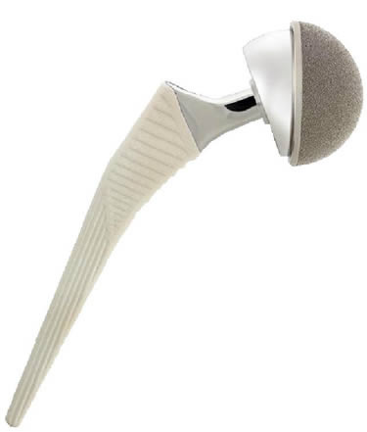
Metal-on-Metal hips types
2005 ASR hips implanted. Same surgeon who preferred long stems.
121 implanted with either SROM or Corail Stems
2002-2010 Additional metal on metal used for revisions and smaller numbers of other types of hips

Slide 7
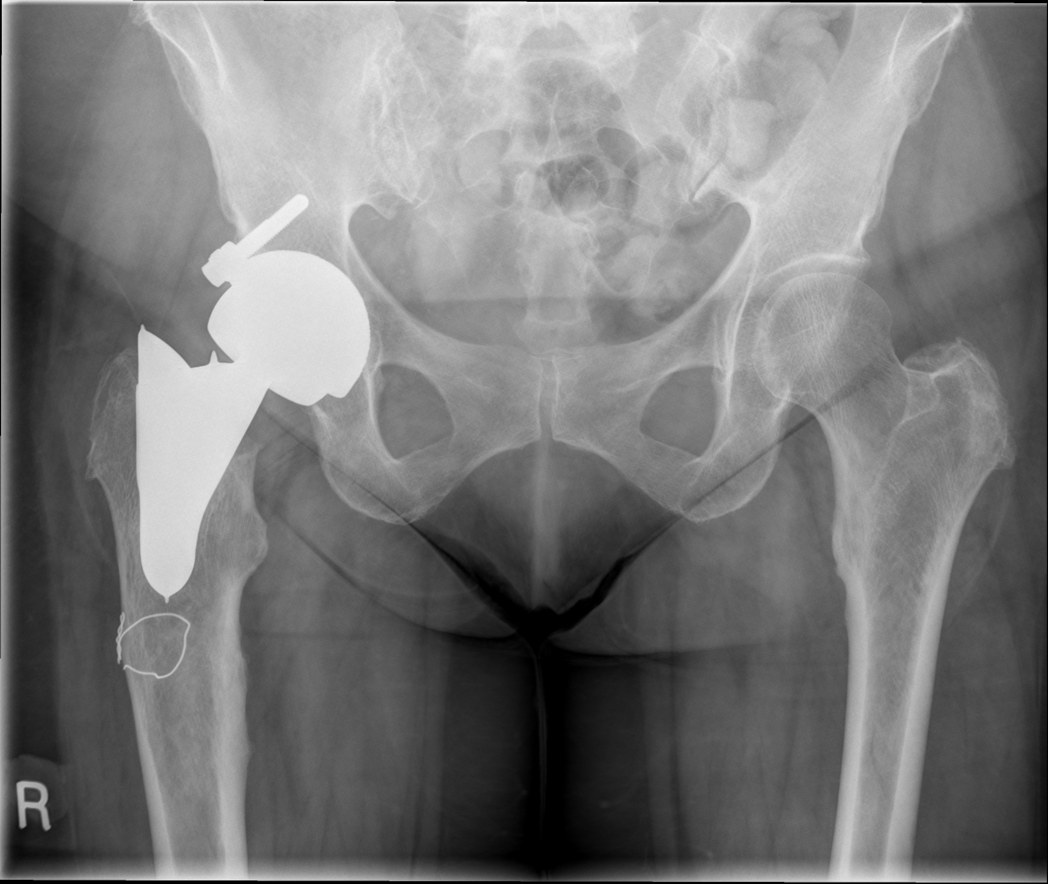
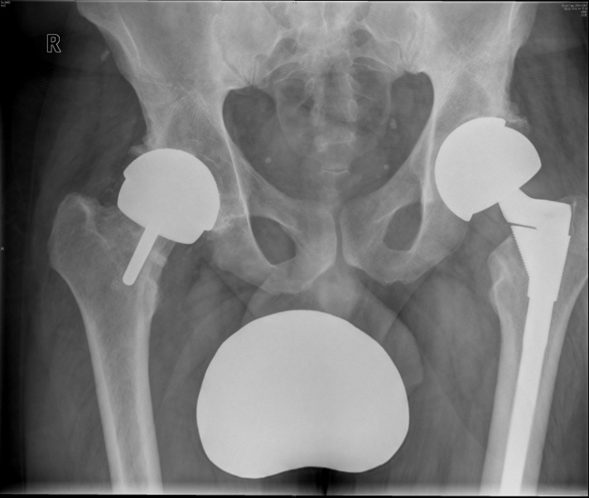
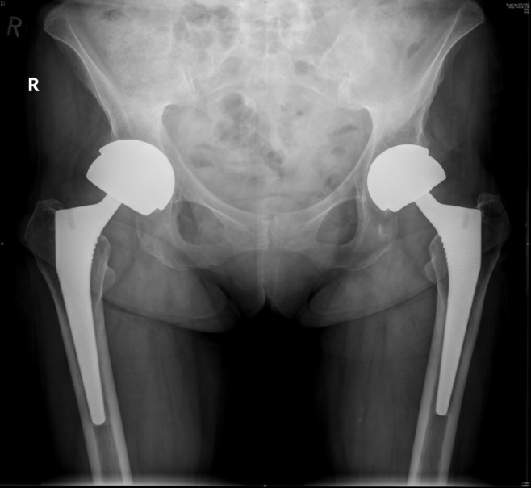
Metal-on-Metal hip types
1998-2010 Metal on Metal hip arthroplasties performed = 854

Slide 8
Research Physio Post
I’ve been in post since 2002.
Follow up clinically and radiologically.
Initially working alongside consultant in clinic.
As numbers and experience increased a separate follow up clinic was setup.
Competency was assured via masters module in x-ray interpretation

Slide 9
Problems arise with M-o-M THR’s
Approx. 2004/5 we started to notice increase in patients complaining of pain and “unhappy” with hip.
Most patients complained of Trochanteric pain and clicking in the groin.

Slide 10
Problems arise with M-o-M THR’s
This coincided with articles reporting complications, Jacobs et al 1998 & 2003, Hallab et al 2005, Park et al 2005.
Up until this point other sources of pain were investigated because x-rays and routine bloods were essentially normal. Many patients were investigated for spinal problems.

Slide 11
Problems arise with M-o-M THR’s
2006 onwards we started looking at blood inflammatory markers.
Inconclusive results
Urine analysis for Chromium(Cr) and Cobalt(Co)started.

Slide 12
Levels of Metal ions in Urine
Literature suggests normal values between 2 and 6nmol/L (Newton et al 2012)
Our cohort of patients showed the following levels of urine metal ions:
Median Cobalt= 334 (2-10,759) nmoL/L
Median Chromium= 97.3 (4-2920) nmoL/L
Urine testing may not be suitable as heavy metal ions are excreted too quickly to be found at significant levels. For this reason we stopped analysing this.

Slide 13
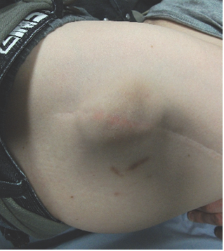
Photo of Trochanteric swelling with Metal-on-Metal THR
Swelling and fluid in the hips was described in the literature Pandit et al 2008.
The Term Pseudotumours was coined (Pandit et al 2008)
These are seen over the Trochanter and in the groin.

Slide 14
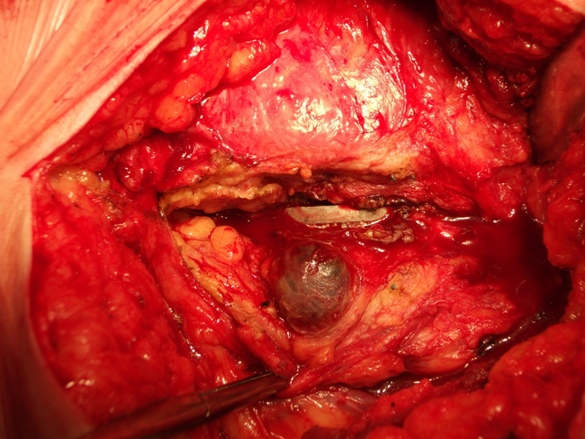
Intraoperative findings
Around this time surgeons were noticing large amount of fluid and necrotic tissue when revising hips.

Slide 15
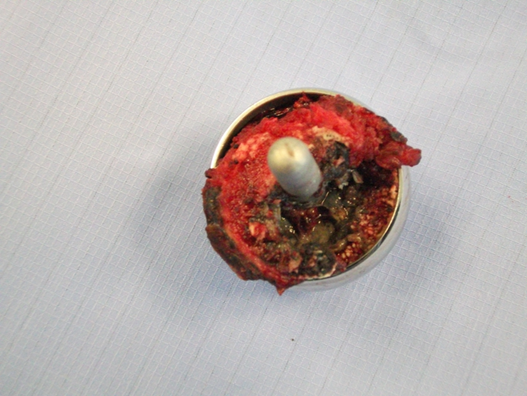
Pseudotumour and necrosis.

Slide 16
Radiological Diagnosis
Started using U/S to look for “Pseudotumours”
Fluid around hip (i.e. in psoas bursa) only was analysed at first
Trochanteric fluid was thought to be bursitis only
Many early signs may have been missed due to inexperience looking at these hips.
Quality of tissues was not examined initially.

Slide 17
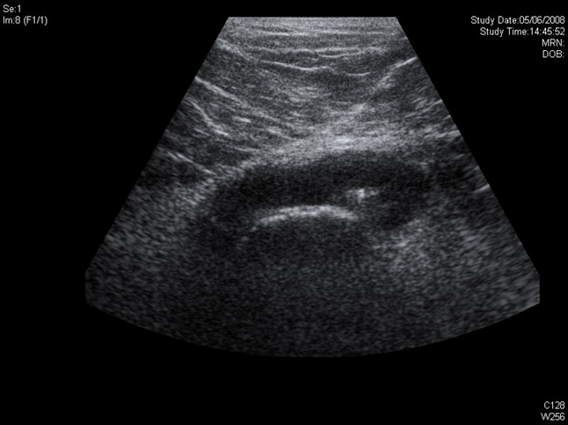
Ultrasound of fluid in the hip joint

Slide 18
Change of focus on Metal-on-Metal hips.
2007 a protocol was developed by the Surgeon, Hip fellow and Research Physio at Royal Liverpool Hospitals as follows:
All M-o-M patients were followed up:
2 yearly
X-rays
Clinical exam
Blood tests.

Slide 19
Change of focus on Metal-on-Metal hips.
2008 BHS and BOA steering group, MHRA and NJR identified large diameter M-o-M articulations at risk. They suggested orthopaedic teams look at these more closely.
2010 MHRA issued a medical devices alert (MDA) drawing attention to all Metal-on Metal hip replacements.
All metal-on-metal prostheses should be followed up annually until 5 years.
Our protocol was modified again to accommodate the yearly follow ups.

Slide 20
Modified protocol for M-o-M hips
Yearly follow up with:
Clinical Examination
X-ray
Blood tests
Imaging if blood tests were showing metal ions >7ppb.

Slide 21
Blood Metal ion levels
Literature described analysis of metal ions in blood
Many debates on whether whole blood or serum is best to detect metal ions.
Newton et al 2012 suggests serum is better to detect chromium and whole blood to detect cobalt.
MHRA guidelines state whole blood threshold levels.

Slide 22
Metal ion levels
Normal levels of metal ions:
<40nmol/L Chromium
<20nmol/L cobalt
Our cohort median blood metal ion levels:
Chromium= 40.3nmol/L (3-2470)
Cobalt= 45.9nmol/L(12-1304)
MHRA guidelines suggest anything over 7ppb should be further investigated.
That translates to 120nmol/L cobalt and 135 nmol/L Chromium
Confusion in measuring between ppb (parts per billion) and nmol/L (nanomoles per litre)from different labs.

Slide 23
Metal ion measurement
Initially all samples were analysed at the Trace Elements Laboratory in Birmingham as Royal Liverpool Hospitals had not been approved to analyse for Cobalt and Chromium.
Royal Liverpool University Hospitals Laboratory is now approved as a National Trace Elements Centre therefore these tests have been performed in house since 2011.

Slide 24
Metal ion measurement
Difficulty in taking the blood samples initially.
Theories that the metal needle may cause contamination led to a protocol to be developed where the first 10mls were discarded.

Slide 26
Re-organisation of clinical follow-up
Yearly follow-up meant increased clinic appointments.
ASR specific clinics were set up and funded by the manufacturer.
A specific M-o-M follow-up clinic was developed.
A business plan was developed my myself and the trust to
provide this service.
We now receive referrals to follow up M-o-M hips which were performed in other areas and other countries.

Slide 27
2013 and onwards
Now BHR’s revised 14%
ASR’s revised 55%
Hybrids revised 20%
Others revised 20%

Slide 28
2013 and onwards
Metal Artefact Reduction Series (MARS) MRI now used to detect fluid in the hip.
This is more accurate and can, when read by an experienced member of the radiology team, detect soft tissue degradation such as rupture of the gluteal tendon insertions.
Sometimes this is more evident than fluid alone.
Mars MRI is becoming more specialised in reducing the artefact and therefore more sensitive.

Slide 29
MARS MRI
Showing disruption of the abductor tendons.

Slide 30
MARS MRI
Showing fluid around the Greater Trochanter.

Slide 31
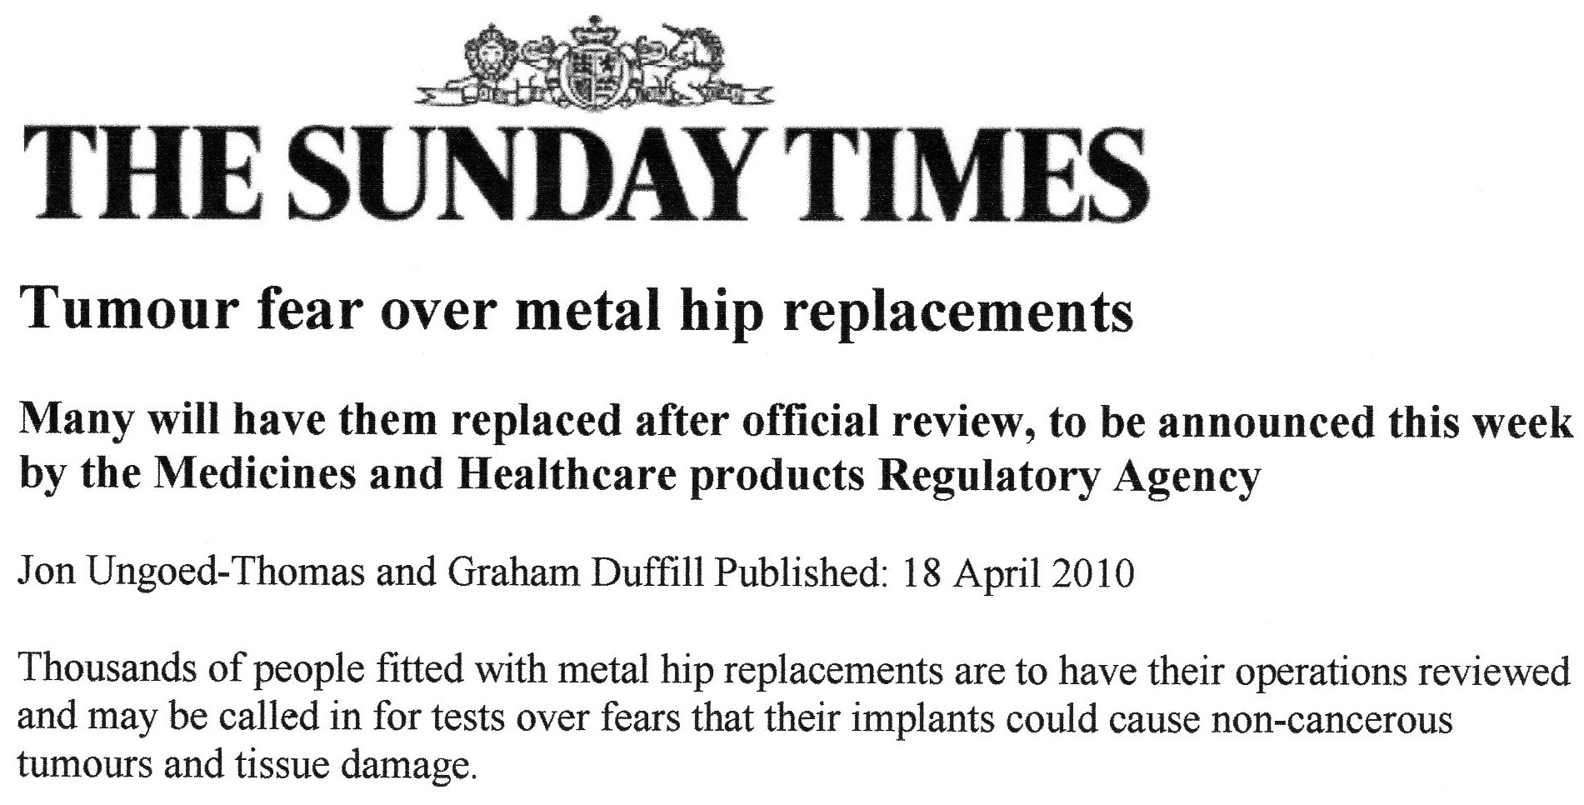
2013 and onward
Issues faced:
Patients need a lot of counselling and support.
Many are angry and confused at “being ignored” for many years.
Media coverage is making people more aware and in some cases is very frightening.

Slide 32
Terms used to describe these reactions.
Pseudotumours
ALVAL (Aseptic Lymphocytic Vasculitis and Associated Lesions) seen on histological analysis of tissue from revisions.
Metal hypersensitivity
These are now all under the umbrella of
ARMD or Adverse Reactions to Metal Debris

Slide 33
How the service is changing
MHRA guidelines 2012 suggest we now follow up all M-o-M hips annually with X-ray and blood tests for the life of the prosthesis.
Due to increased screening more patients are being identified with increased metal ions and no symptoms.
They are dealt with on an individual basis.

Slide 34
How the service is changing
Litigation means that I am dealing with solicitors on a weekly basis and liaising between solicitors, the manufacturer and the NHS.
Providing proof of implants and outcomes to solicitors.
This is not a job that can be done by clerical staff as operation notes, implants and investigation outcomes need to be analysed.

Slide 35
How the service is changing
Clinical practicalities = more time to deal with the increased numbers of patients and their need for counselling.
Liaising with the consultants about arrangements for aspiration and revision.
Lifetime commitment for the lifetime of the prosthesis at present but this may change.

Slide 36
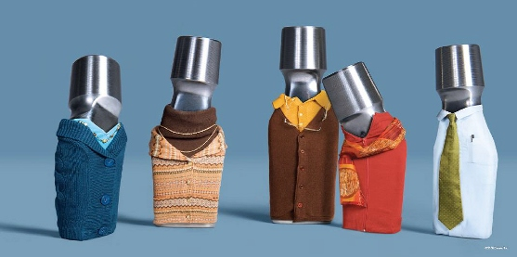
However the Prostheses are dressed up, all metal on metal hips need to be followed up.
Thank You

Slide 37
Publications from our unit on M-o-M hips
Newton, A. W., Ranganath, L., Armstrong, C., Peter, V. & Roberts, N.B. (2012) Journal Of Orthopaedic Research (Oct). 1640-1646: Differential Distribution of Cobalt, Chromium, and Nickel between Whole Blood, Plasma and Urine in Patients after Metal-on-Metal (MoM) Hip Arthroplasty.
Metal ion levels decrease after revision for metallosis arising from large diameter metal on metal hip arthroplasty. D Ebreo, A Khan, M El-Meligy, C Armstrong, V Peter. Acta Orthopedica Belgica. 2011, 77,777-781
Correlation between inclination of the acetabular component and metal ion levels in metal on metal hip resurfacing / replacement. A Khan, D Ebreo, A Khan, M El-Meligy, C Armstrong, V Peter. J.Orthopaedics 2011;8(1)e16

Slide 38
References
Jacobs, JJ. Hallab, NJ. Skipor, AK & Urban RM (2003). Metal Degradation Products. A cause for concern in metal-metal bearings? Clinical Orthopaedics and Related Research 417, 139-147.
Hallab, NJ. Anderson, S. Staffordd, T. Glant, T & Jacobs JJ (2005). Lymphocyte responses in patients with total hip arthroplasty. Journal of Orthopaedic Research 23; 384-391.
Park, Y. Moon, Y. Lim S. Yang, J. Geunghwan, A & Choi Y (2005). Early Osteolysis following second generation metal-on-metal hip replacement. JBJS (Am) 87-A: 1515-1521.
Pandit, H. Glyn-Jones, S. McLardy-Smith, P. Gundle, R. Whitwell, D. Gibbons, CL. Ostlere, S. Athanasou, N. Gill, HS & Murray DW (2008). Pseudotumours associated with metal-on-metal hip resurfacings. JBJS (Br) 90 (7); 847-51.

Slide 39
Bibliography
Daniel J, Ziaee H, Pradhan C, Pynsent PB, McMinn DJ. Blood and urine metal ion levels in young and active patients after Birmingham hip
resurfacing arthroplasty: four-year results of a prospective longitudinal study. J Bone Joint Surg Br. 2007 Feb;89(2):169-73
7. Daniel J, Ziaee H, Pradhan C, McMinn DJ. Six-year results of a prospective study of metal ion levels in young patients with metal-on-metal hip
resurfacings. J Bone Joint Surg Br. 2009 Feb;91(2):176-9
Davies AP,Willert HG, Campbell PA, et al. An unusual lymphocytic perivascular infiltration in tissue around contemporary metal-on-metal joint replacements. J Bone Joint Surg Am. 2005;87:18–27.
Metal-on-metal hip replacement and hip resurfacing arthroplasty. What does the MHRA medical device alert mean? http://www.jisrf.org/pdf_files/MoM_BOA-BHS_AdvicetoSurgeons_1.pdf
Malviya A. et al. Metal-on-Metal Total Hip Arthroplasty. J. Bone Joint Surg. Am. 2010; 92: 1675 - 1683.
MacDonald SJ. A consensus paper on metal ions in metal-on-metal hip arthroplasty. J. Arthroplasty.
2004; 19: Sppl. 3 12-16.
Kim PR. et al. Cobalt and chromium levels in blood and urine following hip resurfacing arthroplasty with the conserve plus implant. J. Bone Joint Surg. Am., 2011; 93: 107 - 117.
Haddad, FS. et al. Metal-on-metal bearings: The evidence so far. J Bone Joint Surg Br, 2011; 93-B: 572 -
579.
Shimmin AJ, Back D. Femoral neck fractures following Birmingham hip resurfacing: a national review of 50 cases. J Bone Joint Surg Br2005;87:463-4.
CrossRefMedline
Finsbury Orthopaedics. ASR marketing and science. Bulletin No 58. 2006. Access link here.
De Haan R, Pattyn C, Gill HS, Murray DW, Campbell PA, De Smet K. Correlation between inclination of the acetabular component and metal ion levels in metal-on-metal hip resurfacing replacement. J Bone Joint Surg Br2008;90:1291-7.
CrossRefMedline
↵ Langton DJ, Sprowson AP, Joyce TJ, Reed M, Carluke I, Partington P, et al. Blood metal ion concentrations after hip resurfacing arthroplasty: a comparative study of articular surface replacement and Birmingham Hip Resurfacing arthroplasties. J Bone Joint Surg Br2009;91:1287-95.
CrossRefMedline
↵ Morlock MM, Bishop N, Zustin J, Hahn M, Rüther W, Amling M. Modes of implant failure after hip resurfacing: morphological and wear analysis of 267 retrieval specimens. J Bone Joint Surg Am2008;90(suppl 3):89-95.
CrossRefMedline
↵ Lee RK, Essner A, Longaray J, Wang A. Metal-on-metal bearings: the problem is edge-loading wear. Surg Technol Int2010;20:303-8.
Medline
Langton DJ, Joyce TJ, Mangat N, Lord J, Van Orsouw M, Smet KD, et al. Reducing metal ion release following hip resurfacing arthroplasty. Orthop Clin North Am2011;42:169-80.
Medline
↵ McMinn Centre. Northern lights debate ASR vs BSR. Access link here.
Langton DJ, Joyce TJ, Mangat N, Lord J, Van Orsouw M, Smet KD, et al. Reducing metal ion release following hip resurfacing arthroplasty. Orthop Clin North Am2011;42:169-80.
Medline
↵ McMinn Centre. Northern lights debate ASR vs BSR. Access link here.
Langton DJ, Joyce TJ, Mangat N, Lord J, Van Orsouw M, Smet KD, et al. Reducing metal ion release following hip resurfacing arthroplasty. Orthop Clin North Am2011;42:169-80.
Medline
↵ McMinn Centre. Northern lights debate ASR vs BSR. Access link here.
Lavigne M, Belzile EL, Roy A, Morin F, Amzica T, Vendittoli P-A. Comparison of whole-blood metal ion levels in four types of metal-on-metal large diameter femoral head total hip arthroplasty: the potential influence of the adapter sleeve. J Bone Joint Surg Am2011;93:128-36.

