Slide 1
GAME CHANGES FOR ARTHROPLASTY FOLLOW UP, NICE AND COMMISSIONERS BASK 2014, Norwich
Lindsay K Smith PhD, MSc, MCSP
NIHR Clinical Lecturer, Bristol

Slide 2
Percentage of GDP spent on healthcare
Source: World Healthcare Statistics 2010

Slide 3
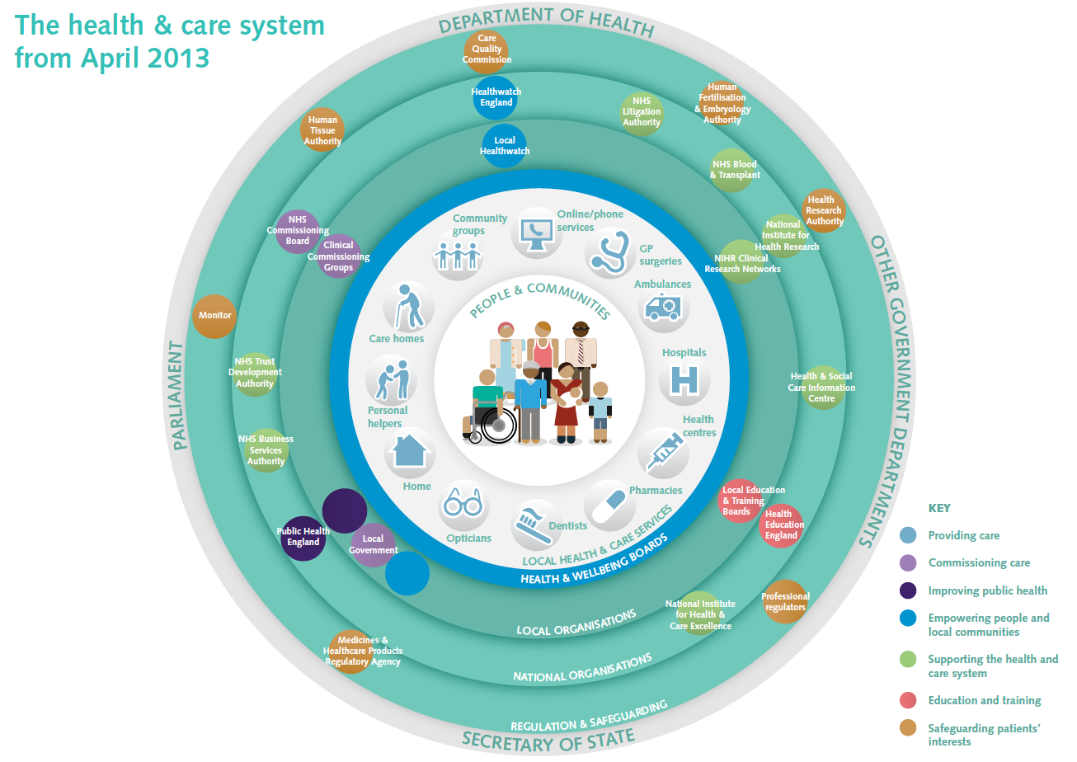

Slide 4
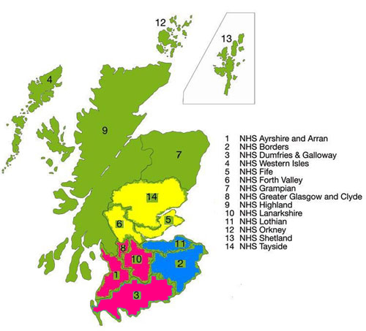
NHS Scotland – 14 regional boards

Slide 5
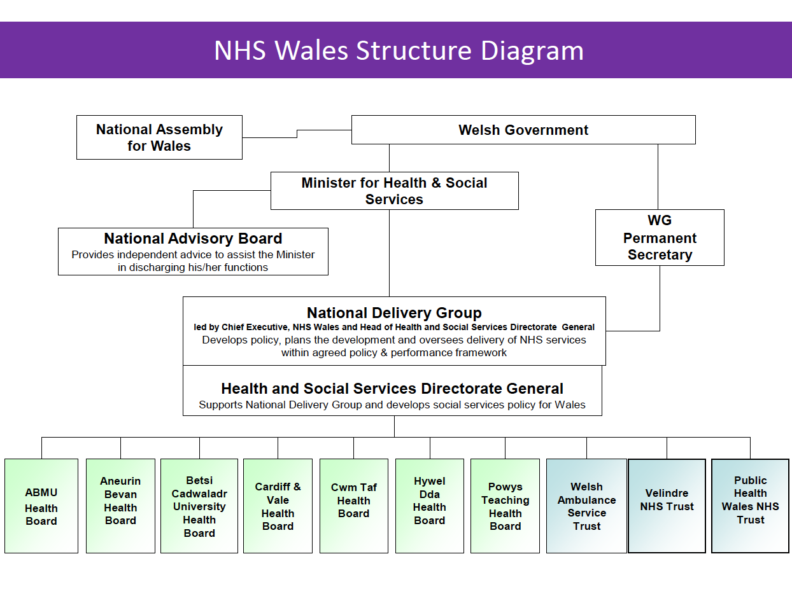

Slide 6
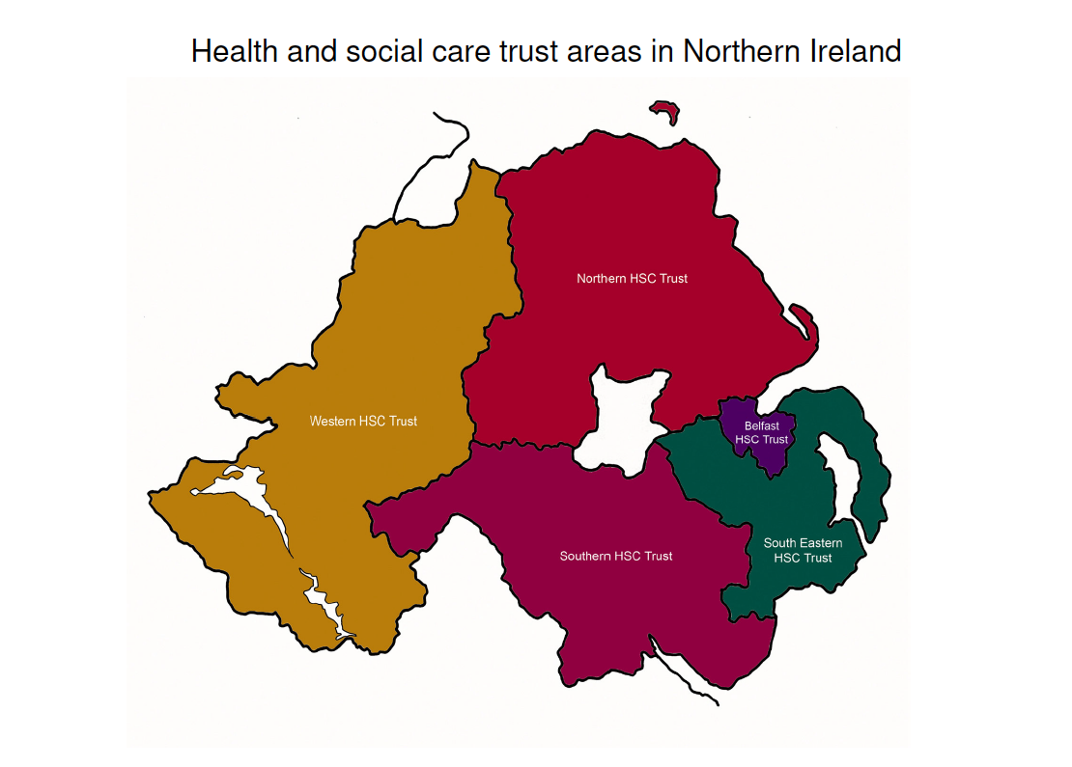

Slide 7
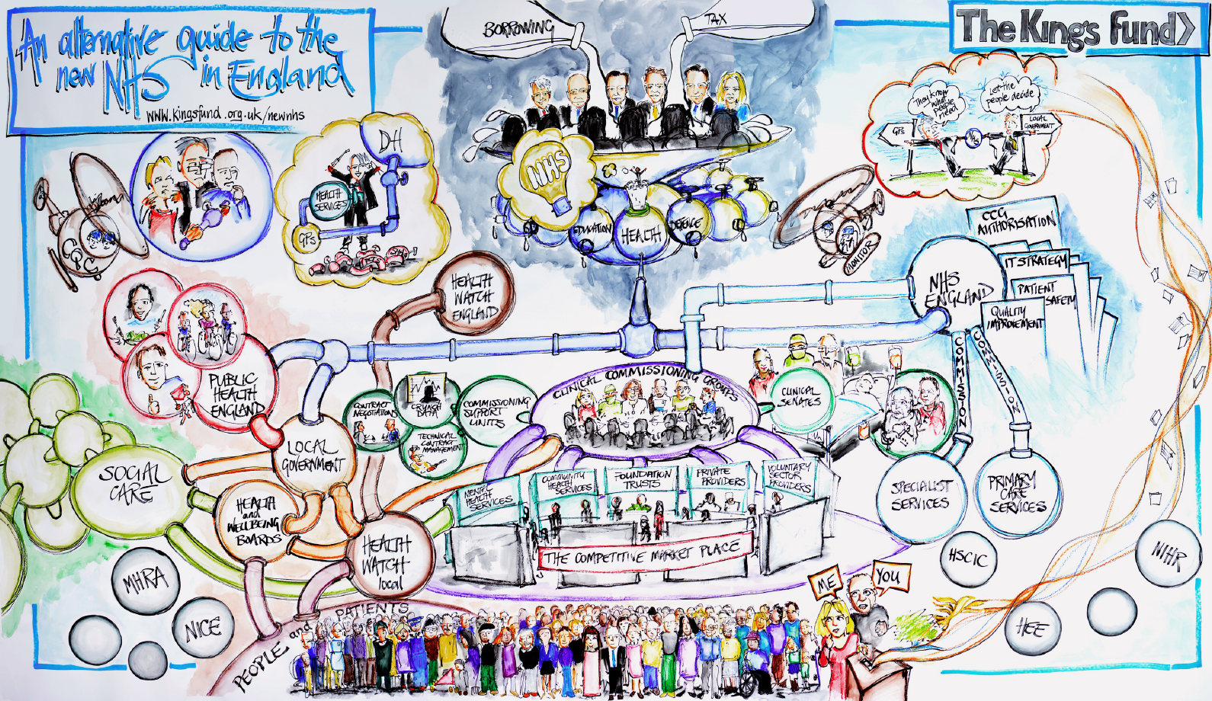
NHS England
Notes:
New Chief Executive – Simon Stevens. Medical Director Prof Sir Bruce Keogh
211 CCGs, 12 Clinical Senates, 4 Strategic Clinical Networks

Slide 9
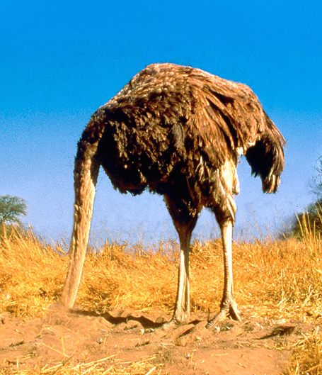
What are the implications for us?
No ostrich mentality
Collaboration not competition
Cross the boundaries
Patient focus - need versus want
Unique selling point
Be aware
Notes:
Add key notes from Karen Middletons talk about getting involved

Slide 10
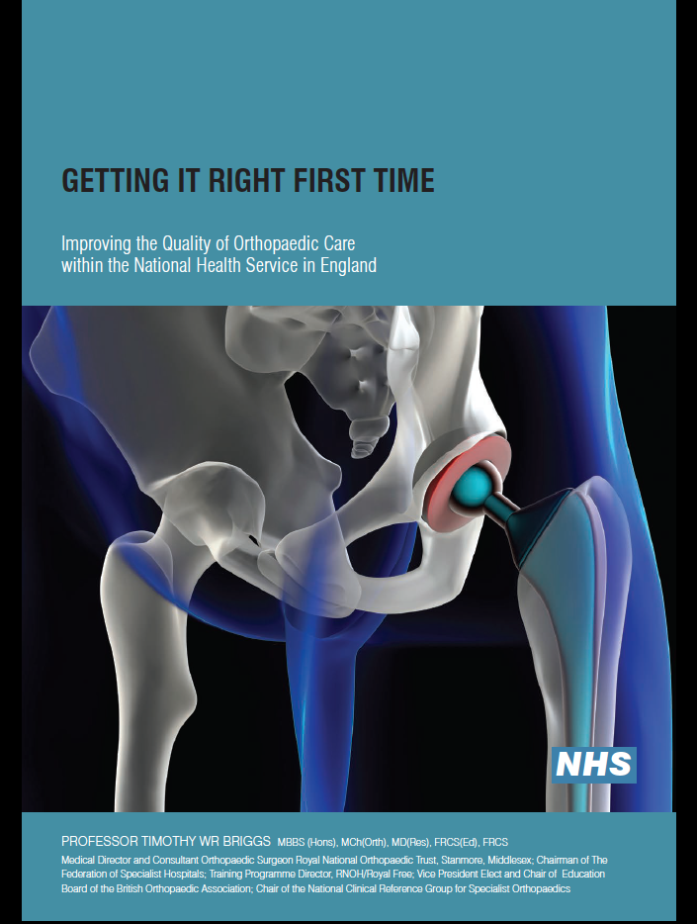
Regional healthcare economies review…
Clinical outcomes
Processes
Patient experience
Patient pathways
Network arrangements
Financial impacts
Waiting times

Slide 11
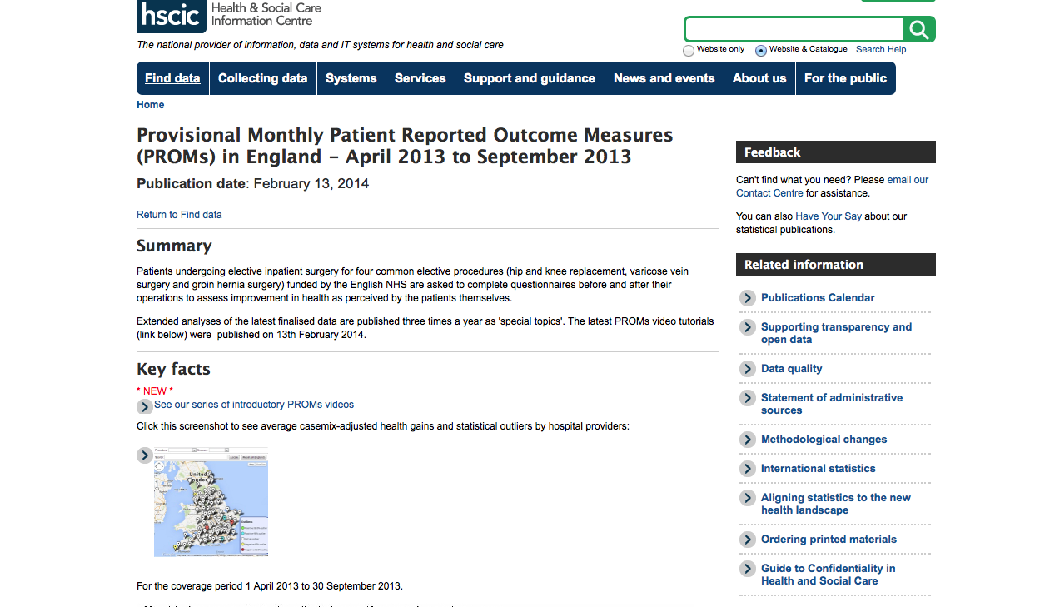

Slide 12
PROMs scores from five hospitals in one region in 2012
Casemix adjusted figures
 | Hip – Oxford score | Hip – EQ-5D score | Knee – Oxford score | Knee – EQ-5D
Average | 21.3 | 0.44 | 16.0 | 0.32
WGH | 21.3 | 0.43 | 15.9 | 0.32
Yeovil DGH | 22.1 | 0.47 | 16.1 | 0.36
Shepton Mallett TC | 23.6 | 0.47 | 16.9 | 0.32
Emerson’s Green TC | 23.6 | 0.47 | 17.2 | 0.32
North Bristol Trust | 20.7 | 0.44 | 15.2 | 0.28
Notes:
April to October 2013 – 74% pre-op questionnaires completed and only 49% of those completed a post-op score.
Casemix adjustment – not perfect yet!
Andrew Street et al 2014, NIHR Health Services and Delivery research, Variations in outcomes and costs among NHS providers for common surgical procedures:.. EQ-5D not best instrument for cost comparisions or patient satisfaction – better to use each dimension in its own right.

Slide 13
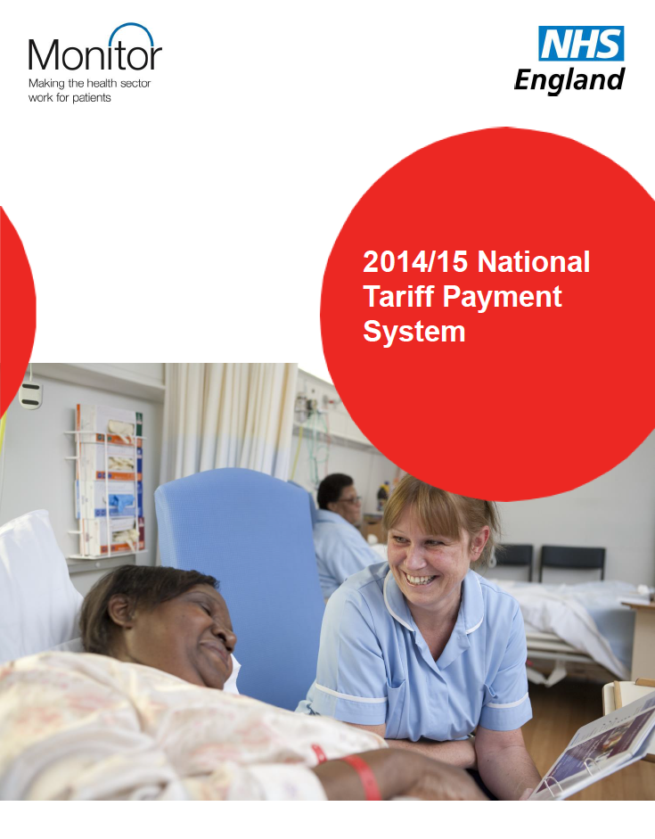
Requirements for Best practice tariff
Health gain in Oxford score equivalent to average or above
PROMs participation at 50%
NJR minimum compliance of 75%
NJR unknown consent rate <25%
HRG code | HRG name | Non-best practice tariff (£) | Best practice tariff (£)
HB12B | Major Hip Procedures for non Trauma Category 1 with CC | 5,367 | 5,963
HB12C | Major Hip Procedures for non Trauma Category 1 without CC | 4,698 | 5,220
HB21B | Major Knee Procedures for non Trauma Category 2 with CC | 5,699 | 6,332
HB21C | Major Knee Procedures for non Trauma Category 2 without CC | 5,078 | 5,642
Notes:
FOR EXAMPLE 300 THA per annum = £1,800,000 if BPT but £1,610,000 if not. This is £200,000 less per annum equivalent to x5 full time arthroplasty practitioners F/T salaries!

Slide 14
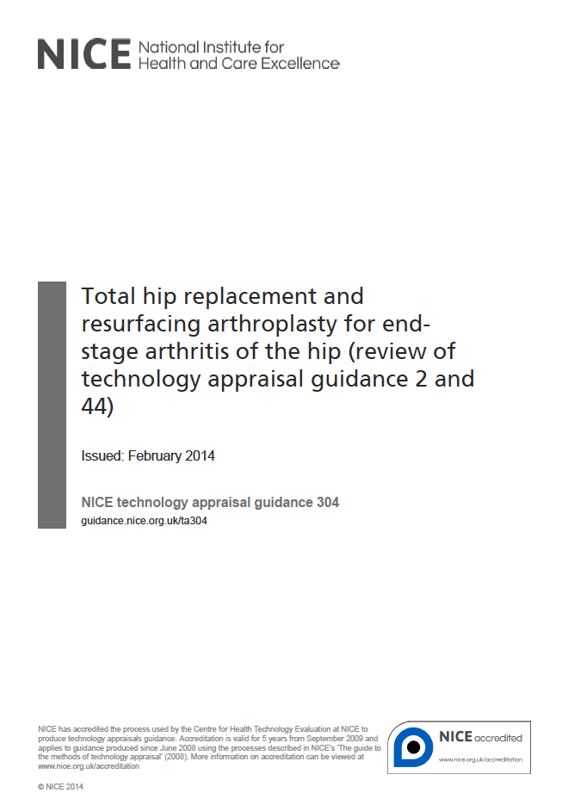
Total hip arthroplasty and hip resurfacing arthroplasty are acceptable for end stage arthritis of the hip as long as the revision rate of the chosen prosthesis is no more than 5% at 10 years.
Risk of revision is part of choice of prosthesis
Women less likely to be offered resurfacing
Risk after revision is associated with mechanism of failure

Slide 15
BRITISH ASSOCIATION FOR SURGERY OF THE KNEE

Slide 16
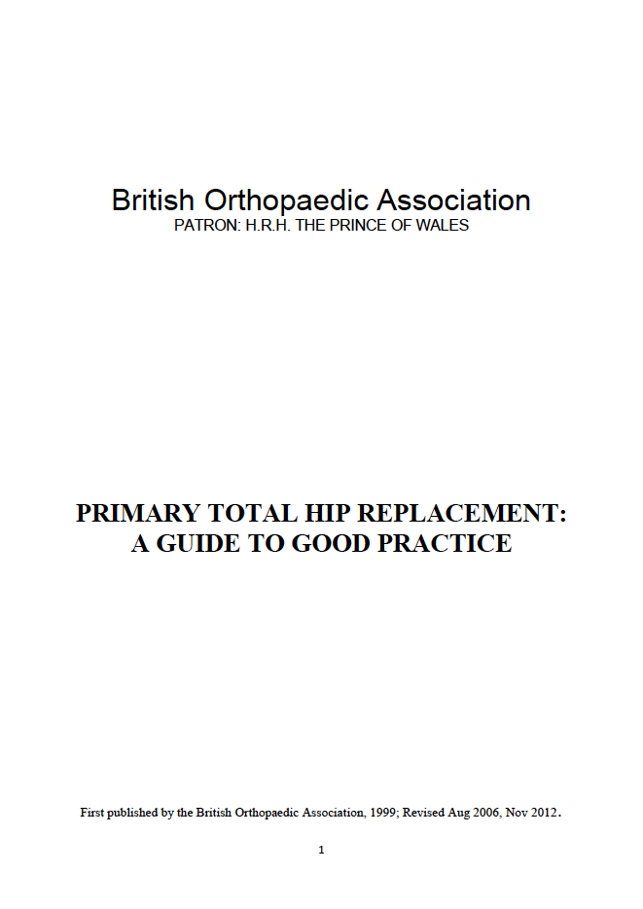
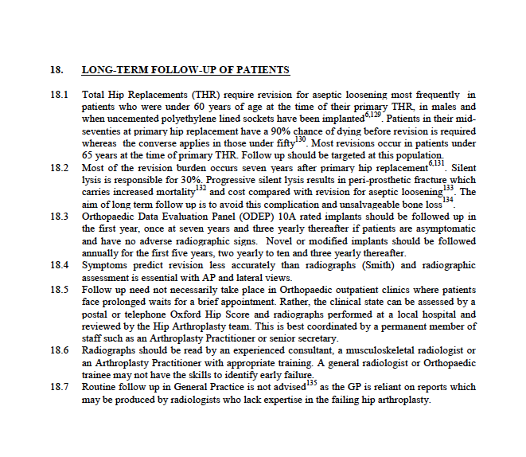
65 years or less at primary are target group for review
ODEP10A implants to be reviewed at at 1, 7, 10 years and 3 yearly thereafter…
X-rays are essential and need to be interpreted by experienced consultant, musculoskeletal radiologist or arthroplasty practitioner with appropriate training
Notes:
Acknowledge Prof Gordon Bannister and Prof Fares Haddad

Slide 17
Arthroplasty practitioner
Band 6 level health care professional
Arthroplasty Image Interpretation
Local protocol
Accountability structure
Level 2: Able to follow up hip and knee patients under supervision with consultant or senior practitioner present in clinic along side
Clinic administration
History taking
Examination
Ordering of appropriate investigation
Interpretation/Relevance of investigations
Assessment of joint replacement
Further follow up of hip or knee – knowledge of actions
Underpinning knowledge
ACPA course at Liverpool
Local training with documentation
IRMER

Slide 18
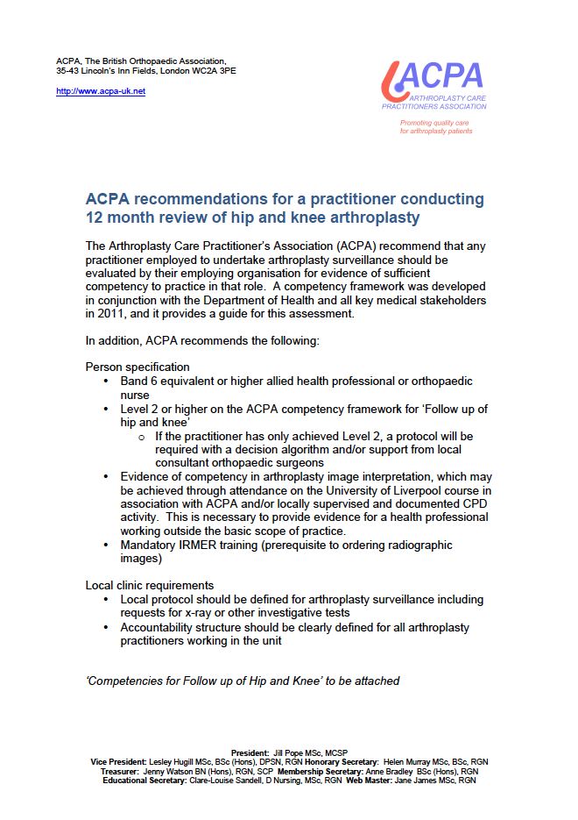
www.acpa-uk.net

Slide 19
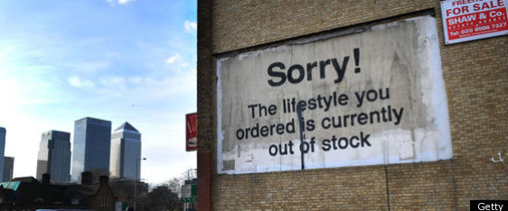
What now?
Be aware of how funding for arthroplasty is changing
Be aware of your local PROMs/other outcomes and NJR data
Encourage wherever you can…
Engage with local commissioners
Apply your clinical experience and knowledge
Critically analyse your own practice
Use your networks
Source: Banksy art work in Canary Wharf, London 2011
Notes:
Encourage – patients and score completion
Own practice – weed out and unnecessary, grow the necessary

