Slide 1

Valgus subsidence of the tibial component in cementless Oxford unicompartmental knee replacement
A.D. Liddle, H.G. Pandit, C. Jenkins, P. Lobenhoffer, W.F.M. Jackson,
C.A.F. Dodd, D.W. Murray
Bone Joint J 2014;96-B:345-9
Physiotherapy Research Unit,
Nuffield Orthopaedic Centre,
Oxford University Hospitals NHS Trust

Slide 2
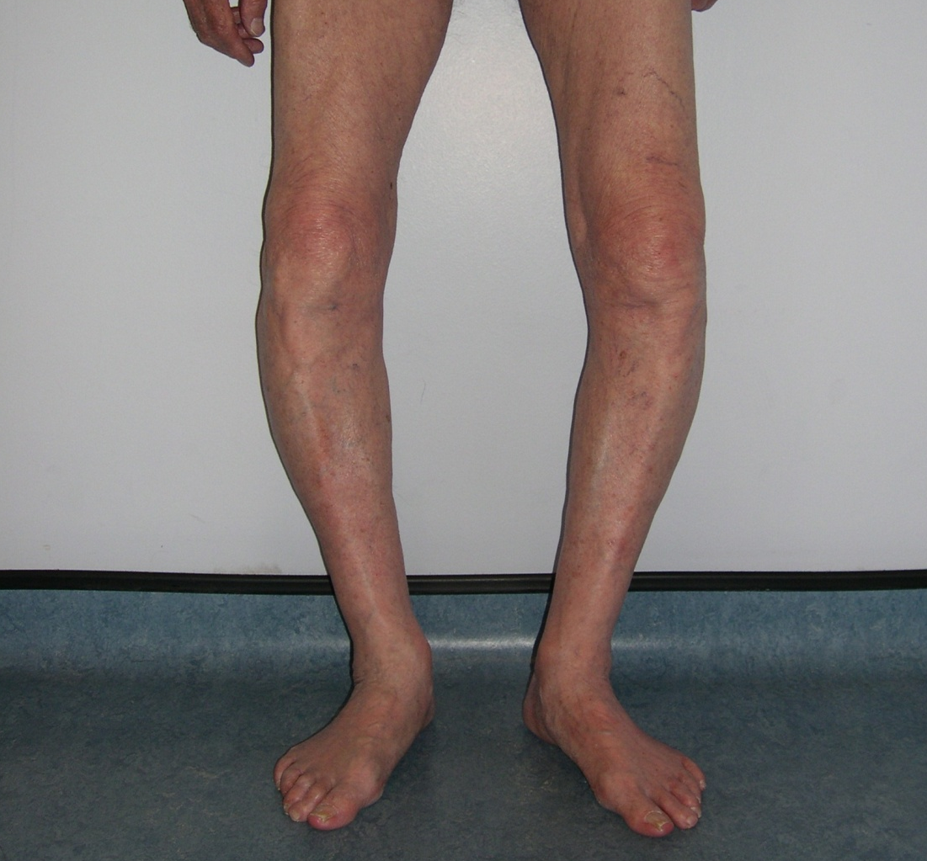

Slide 3
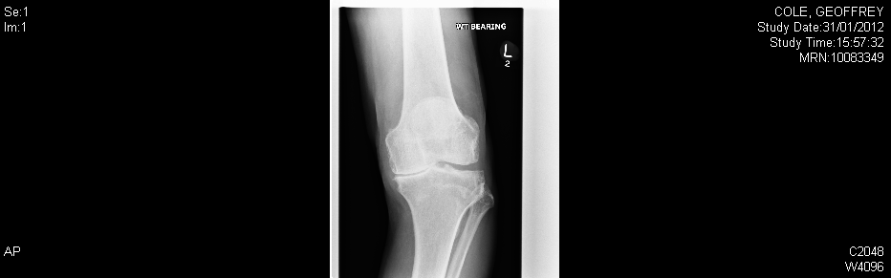
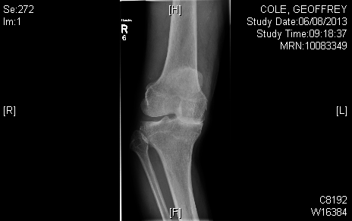

Slide 4
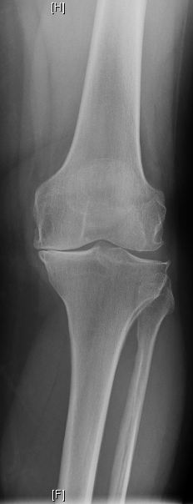
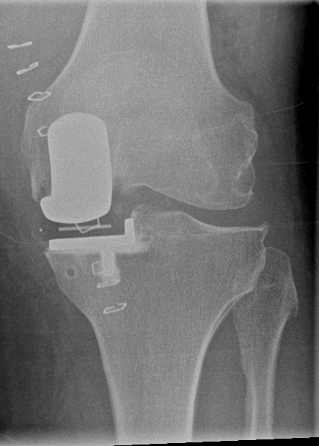
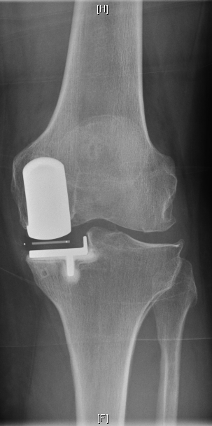
3 yr PO

Slide 5
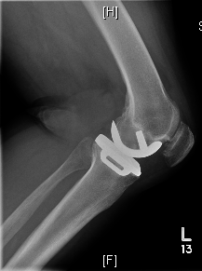

Slide 6
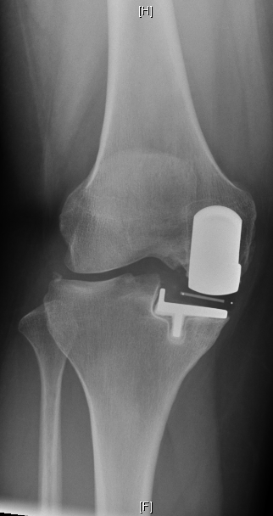

Slide 7
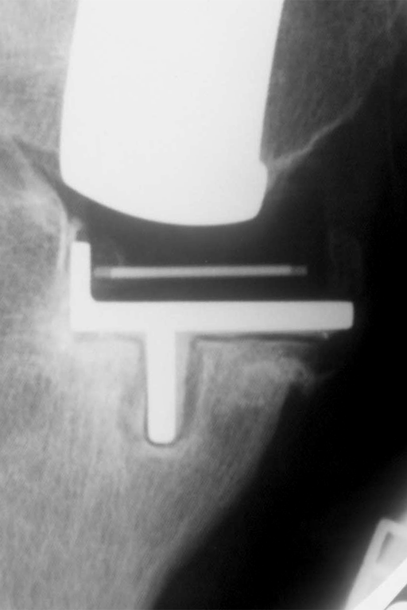
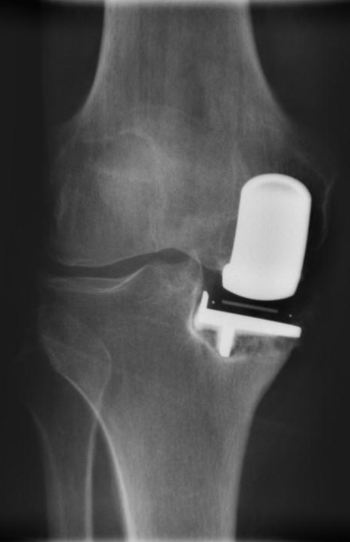
2 Types of Radiolucency
1. Physiological
Narrow, well defined
Common, Not loose
2. Pathological
Poorly defined
With subsidence - Loose
Notes:
7

Slide 8
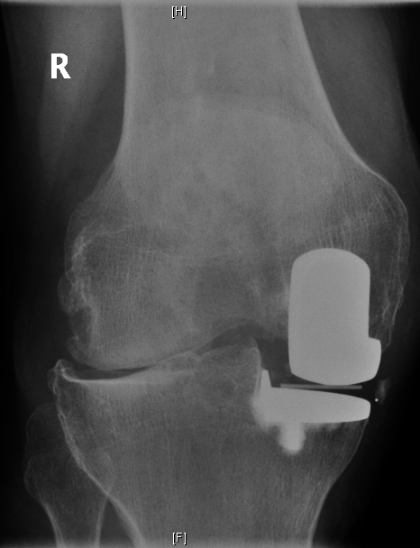
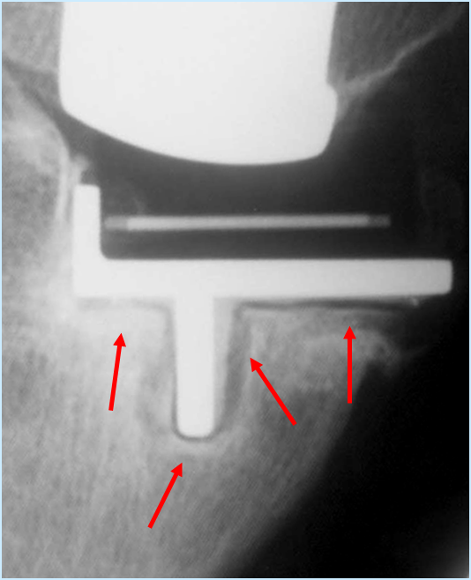

Slide 9
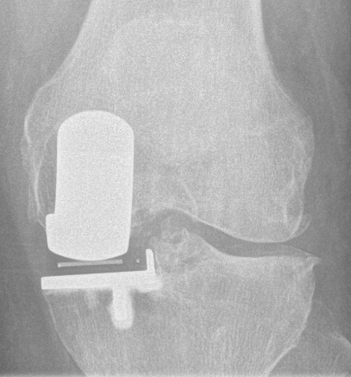
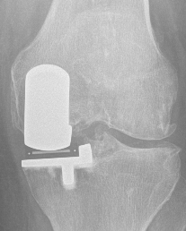

Slide 10
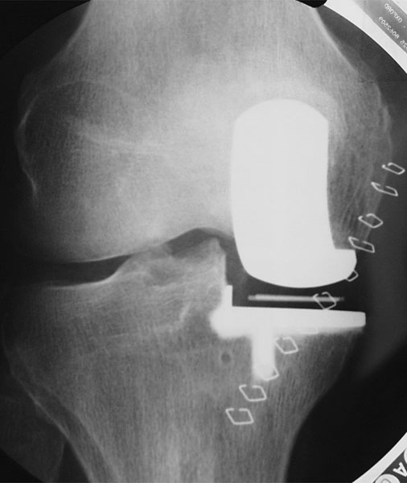
Radiological Assessment of UKR
Radiographs accurately aligned on interface
- comparable
Lateral OA
Implant subsidence
Radiolucency
  Incidence, site, size & type
Notes:
10

Slide 11
Tibia
Horizontal ± 5º
Overhang 0-3mm
Spines preserved
Cement penetration
No saw cuts
Horizontal ± 5º
Overhang 0-3mm
Spines preserved
Horizontal ± 5º
Horizontal ± 5º
Overhang 0-3mm
Horizontal ± 5º
Overhang 0-3mm
Spines preserved
Cement penetration

Slide 12
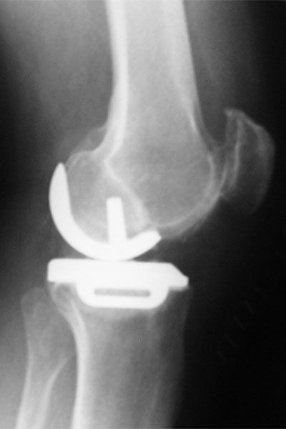
Tibia
7º posterior slope
Flush posteriorly
Anterior unimportant
Tibial axis

Slide 13
Femur
Alignment
Femoral axis
Size
Aligned with cartilage
Fixation
No gaps

Slide 14
Lateral X ray
Impingement
Post. osteophytes
Bone anteriorly
Cement

Slide 15
Femur & Bearing
Femur
Internal rotated
Posterior
Anterior
Bearing
2 wires
Few mm from wall Not overhanging

Slide 17
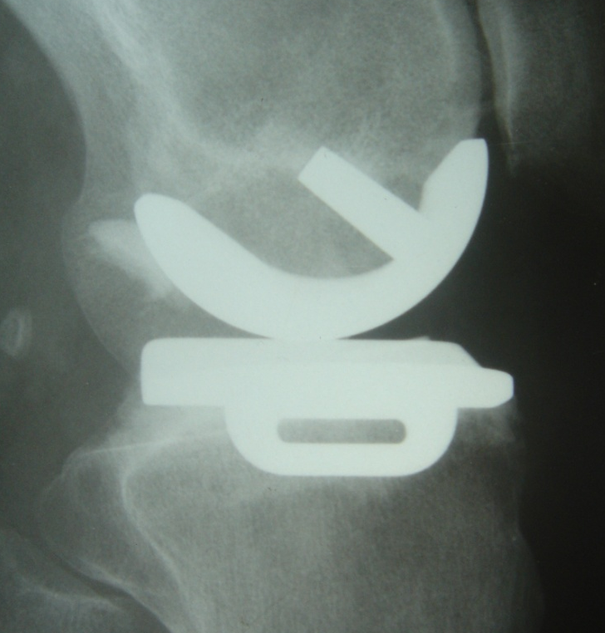
Why Cementless
Cementing errors
  Common cause of failure
Cementing takes 10 or 20 minutes
Bone bonding to implant (HA) may be better in young active patients
Unnecessary revisions for physiological radiolucency

Slide 18
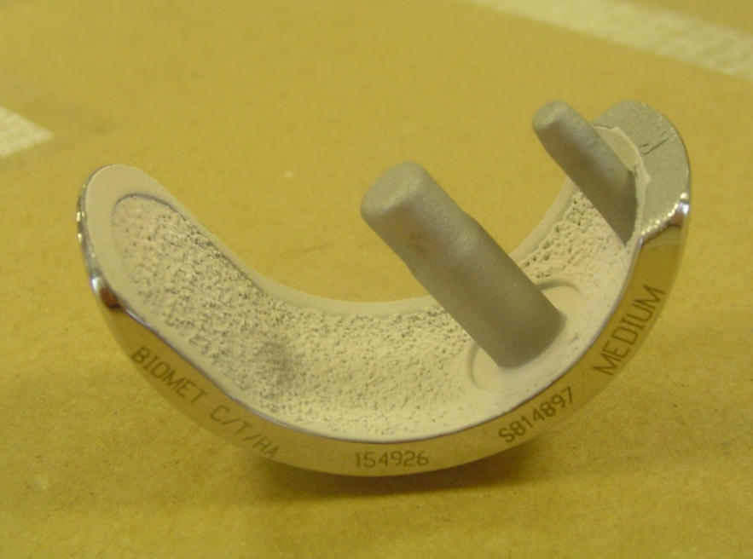
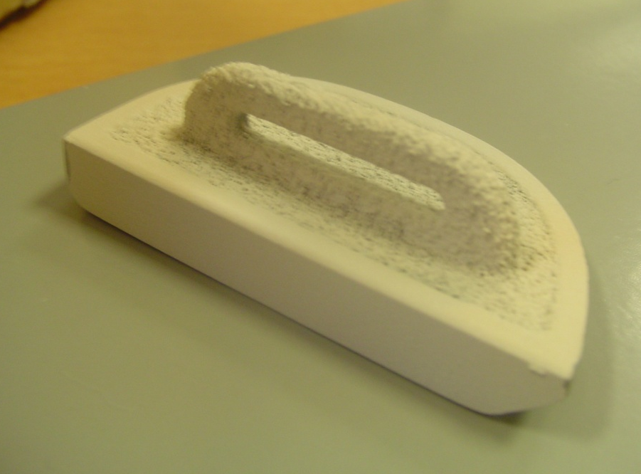
Components
Femur:
- 2 pegs
- HA & Porous coated
-not on pegs
- 15º anterior extension
Tibia:
- Standard component
- HA & Porous coated

Slide 19
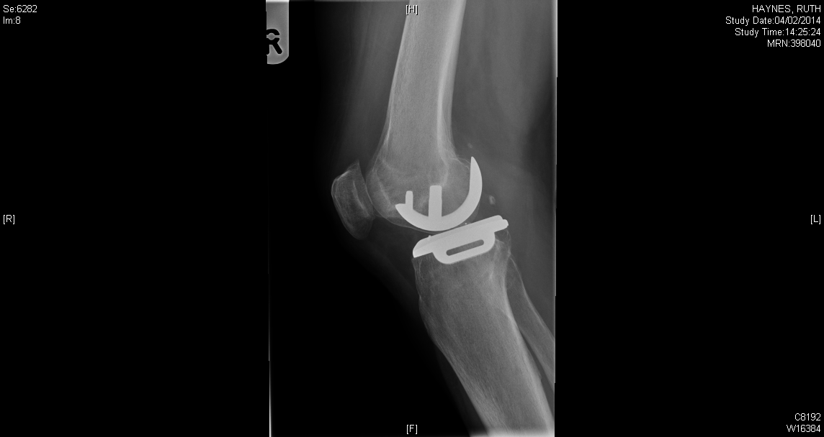
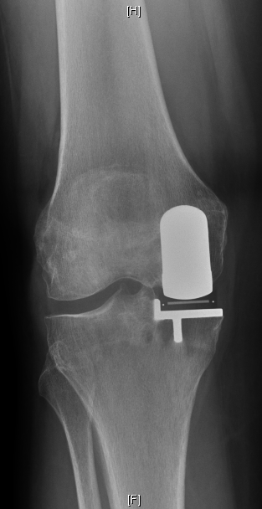

Slide 20
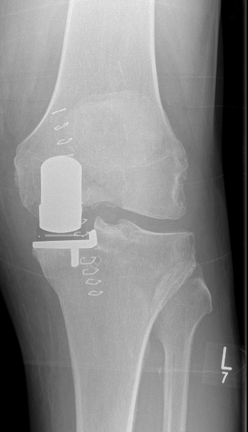
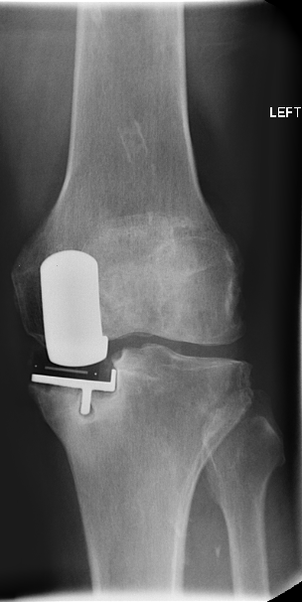
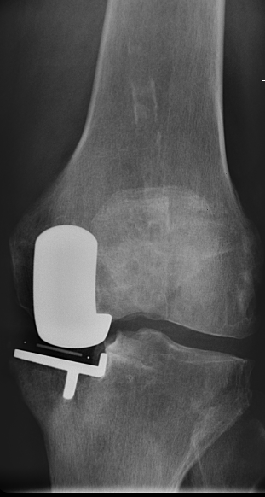
4 months PO
5yrs PO

Slide 21
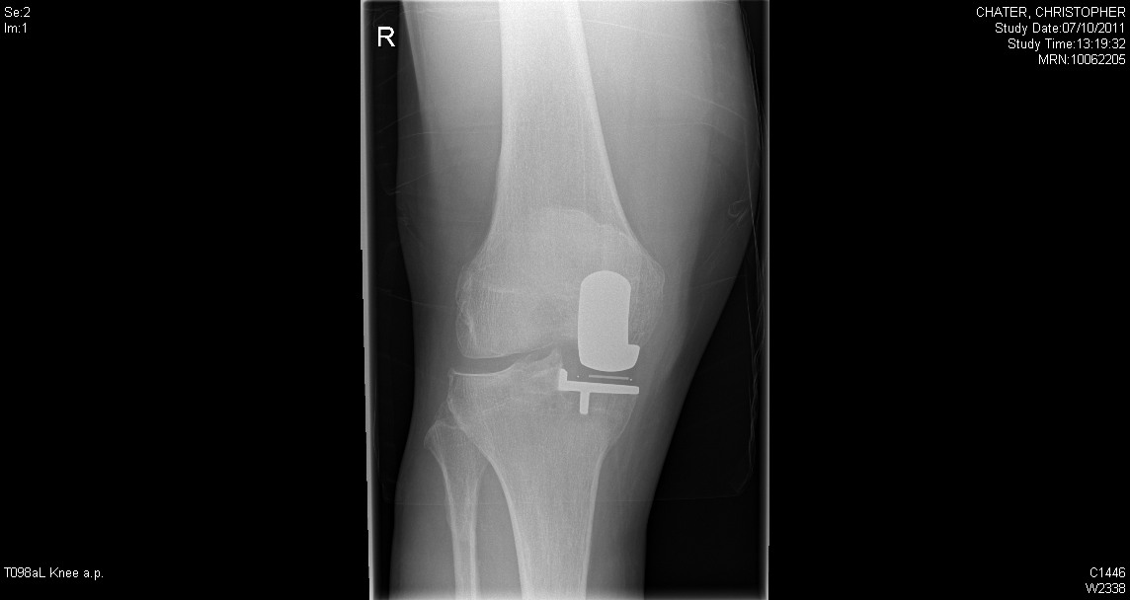
Modifications to surgical technique
Do not position femoral component too lateral
- bearing away from lateral wall

Slide 22
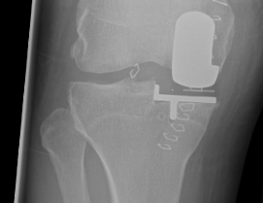
Accept if component not fully seated
- do not use force

Slide 23
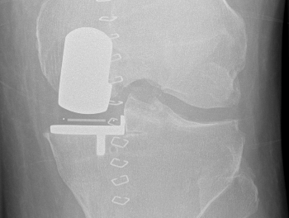
Perform horizontal cut first
- slightly undermine tibial eminence

Slide 24
Sit tibia on posterior cortex

Slide 25
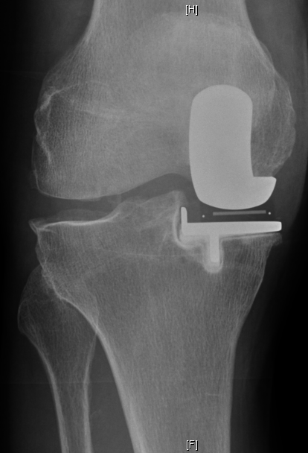

Slide 26
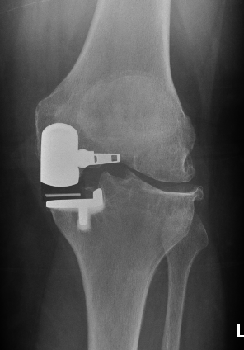
Thank You

Slide 27
Revision to TKR (primary or revision)
100%
80%
60%
10 yr survival 97% (CI 5%)
Survival %
40%
20%
0%
0
2
4
6
8
10
Follow up (years)

Slide 28
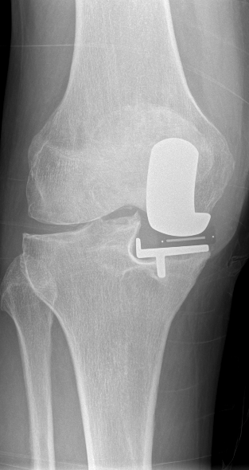
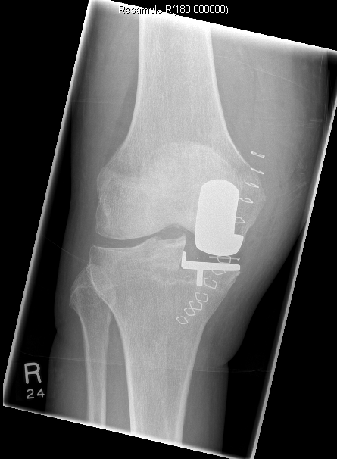
10 months PO

Slide 29
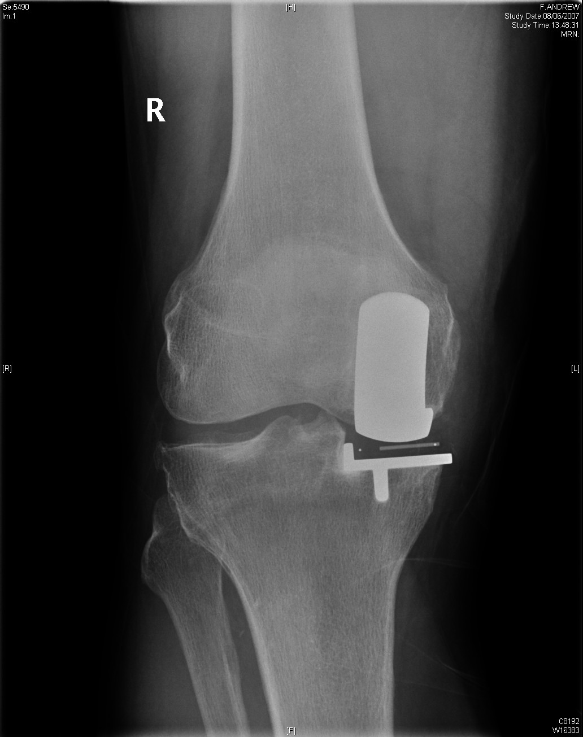
Notes:
29

