Slide 1

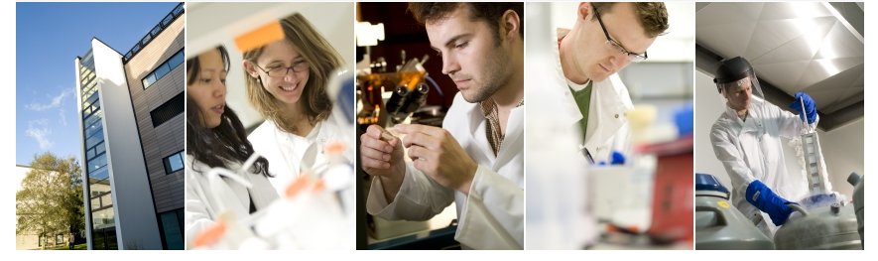
Investigating the chondroprotective properties of isothiocyanates
Rose Davidson
Biomedical Research Centre
University of East Anglia

Slide 2



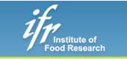
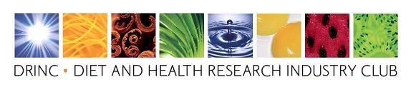
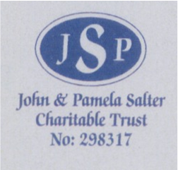




School Of Biological Sciences
Ian Clark
Kirsty Culley
Rose Davidson
Orla Jupp
Sarah Gardner
Jonathan Green
Kimberley Hirst-Jones
Tracey Swingler
Yvette Wormstone
Natalie Crowe
Linh Le
School Of Medicine
Yongping Bao
Aedin Cassidy
Alex Macgregor
Geoffrey Guile
Colin Kay
Rachel de Ferrars
School Of Pharmacy
Rosemary Norton
Maria O’Connell
Institute of Orthopaedics, NNUH
Simon Donell
Sue Butters
Angela Bullough
Tracey Potter
Laura Watts
Institute for Food Research
Richard Mithen
Charlotte Armah
Maria Traka
Kings College, London
Frances Williams
Tim Spector
Kennedy Institute of Rheumatology, Oxford
Tonia Vincent
Olga Boruc
Clare Driscoll
NIHR Flexibility and Sustainability Funding
NIHR Flexibility and Sustainability Funding
HG Blake Ltd
HG Blake Ltd

Slide 3
Osteoarthritis – the problem
8.5 million people have OA in UK, 71% of which are in constant pain.
By 2030 >17 million projected to have OA (50% population >50yrs).
OANation 2012 Report: 49% of OA patients visiting GP:
‘would like more information about other areas of life that might affect their OA such as diet and exercise.’
Development of functional foods or food products, beneficial in the treatment or prevention of OA.
Wang, McPherson et al (2011).

Slide 4
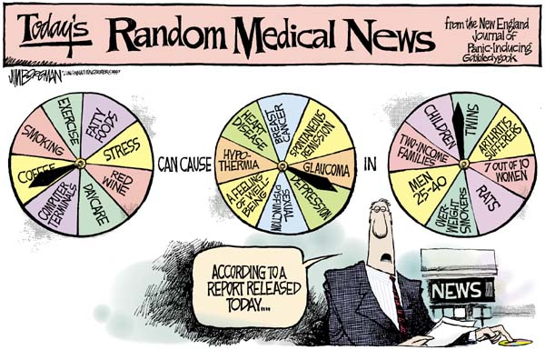
How can we stop cartilage degradation?
Dietary factors

Slide 5
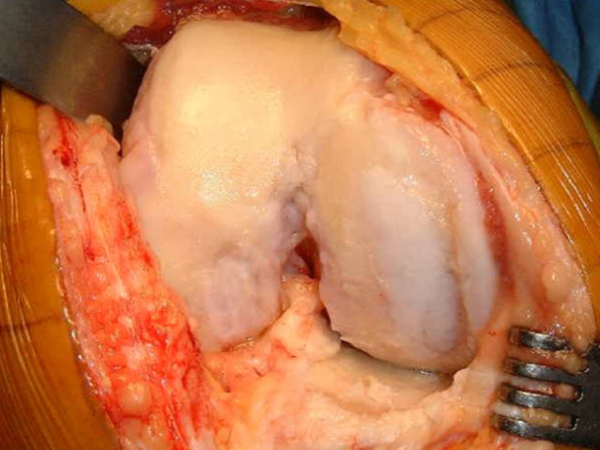
Changes in cartilage during OA
Biochemical changes
  decrease in aggrecan
  damage to the type II collagen network
Morphological changes
  fibrillations/pitting
  softening and loss of cartilage thickness
Changes in gene expression
NORMAL
OSTEOARTHRITIC

Slide 6
Metalloproteinases and their inhibitors
Matrix metalloproteinases
23 human enzymes
(Collagenases MMP-1, -8, -13, -2, -14?)
ADAMTSs
19 human enzymes
(Aggrecanases ADAMTS-1, -4, -5, -8, -9, -15?)
TIMPs
4 human inhibitors

Slide 7
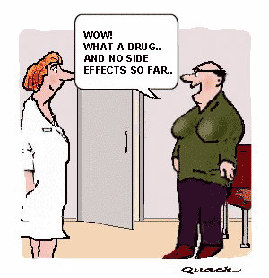
How can we stop cartilage degradation?
Dietary factors
Wow!
What a drug… and no side effects so far…

Slide 8
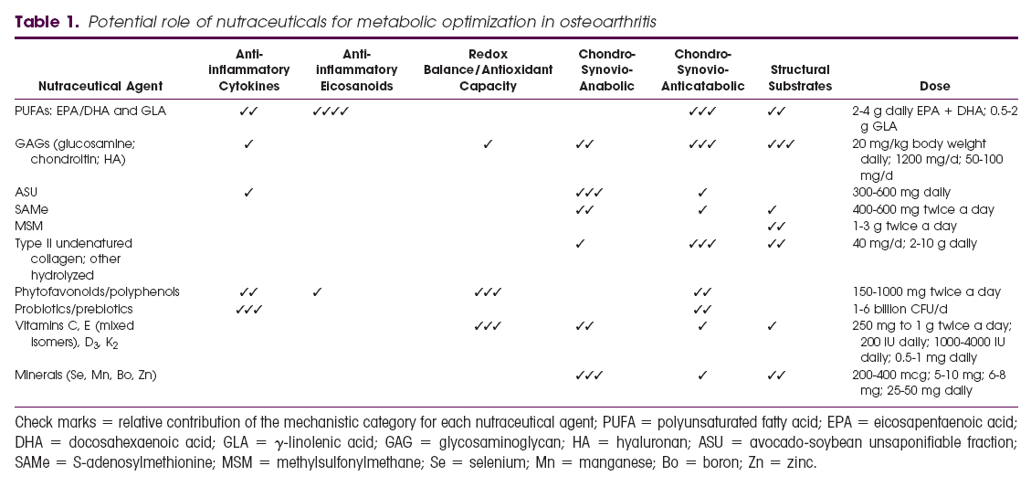
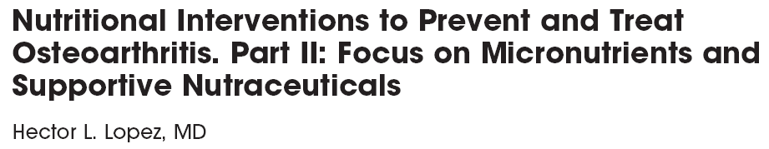
Dietary-derived factors and osteoarthritis
Best studied: chondroitins and glucosamine
Systematic analyses: small effect for pharmaceutical grade chondroitin sulfate.
Notes:
From some reviews it could see that we know a lot about the impact of diet or nutraceuticals in OA… this review shows agent, mechanism and even dose needed.
Evidence for any of this is scant though
Best studied would be chondroitins and glucosamine, where the systematic analyses suggest a small effect for pharmaceutical grade chondroitin sulfate.

Slide 9
Dietary-derived factors and osteoarthritis - Models
Vitamins A, B(1, 2, 3, 6), C, D, E, K
n3 vs n6 PUFA
Flavonols (quercetin, kaempferol, myricetin)
Flavones (apigenin, luteolin, tangeritin, nobiletin)
Flavan-3-ols (EGCG, proanthocyanadins)
Anthocyanins
Isoflavones (soy, genistein)
Flavanones (hesperetin, naringen)
Carotenoids (lutein, zeaxanthin, beta-cryptoxanthin)
Plant sterols (stigmasterol, campesterol)
Glucosinolates (glucoraphanin)
Resveratrol
Curcumin
Avocado-soybean unsaponifiables
Ginger
(extract of edible bird’s nest)
Thoroughness?
Cell data
Explant work
Animal model data
Dose?
Method of delivery?
Notes:
Many diet derived molecues have been examined in models of OA. The problem is that this hasn’t been thorough.. So may be some cell data, or explant… then for some
even some animal model data… but rarely all of them. And doses may be industrial, or mouse models with intraarticular or intraperitoneal injection rather than diet.
So, evidence for any of them is patchy

Slide 10
Intervention trials - osteoarthritis
Vitamin C
  Peregoy et al 2011 Public Health Nutr 14:709-15
Vitamin E
  Canter et al 2007 Rheumatology 46:1223-33
Vitamin D
  McAlindon et al 2013 JAMA 309:155-62
Tart cherry juice
  Schumacher et al 2013 Osteoarthritis Cart 21:1035-41
Soy
  Arjmandi et al 2004 Phytomedicine 11:567-75
Curcumin (phosphatidyl choline complex)
  Belcaro G et al 2010 Panminerva Med 52:55-62
Avocado-soybean unsaponifiables
  Maheu et al 2014 Ann Rheum Dis 73:376-84
Ginger
  Leach et al 2008 Int J Evid Based Healthc 6:311-20
Small scale
Interpretation
Notes:
These are the recent intervention trials in man. Many are small scale and not easily interpretable.
Even where they are well designed, eg vit D, where epidemiology and lab data was very strong, the outcome shows no effect (over a 2 year intervention) or even a worse outcome
Some possibilities shown by curcumin, but this is a complex, made more bioavailabe, so not a true dietary intake

Slide 11
Observational Study
St Thomas’ Twins UK registry
Matched co-twin case control design compares discordant exposure- disease status
Radiographic OA determined at the hand hip and knee
Lumbar and cervical degeneration assessed by MRI
Notes:
We did some epi in Twins (Alex MacGregor, Aedin Cassidy, Fran Williams, Tim Spector)

Slide 12
Peripheral Joints
Notes:
Positive association with hip OA for diet A
Diet split into principle components from a previous analysis to help deal with problems of multiple testing

Slide 13
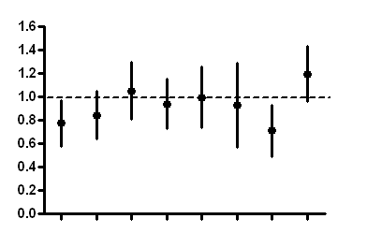
Fruit and vegetable pattern at the hip
Odds ratio
Citrus fruit
Allium vegetables
Yellow vegetables
Non-citrus fruit
Other vegetables
Cruciferous vegetables
Chips and roast potatoes
Green leafy vegetables
Notes:
When deconvolute, alliums and non citrus fruit assoication remains, cruciferous almost

Slide 14
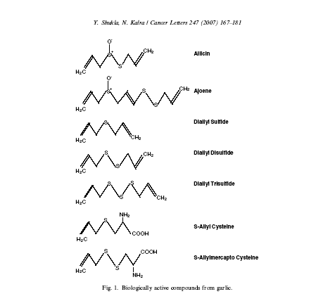
Laboratory studies
Organosulfur compounds derived from garlic oil
Notes:
There are a number of compounds in garlic (and other allium vegetables) both water soluble and lipid soluble.
Organosulfur compounds derived from the metabolism of allicin have been shown to have biological activities

Slide 15
Diallyl disulphide regulates the expression of key MMP genes

Slide 16
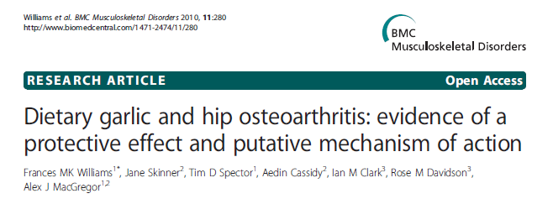
Summary
Matched analysis indicates that these findings are less likely to be confounded by other lifestyle factors
However, the effects are small effects and (despite the dietary pattern approach) not robust to multiple testing

Slide 17
Fruit and vegetable pattern at the hip
Odds ratio
Citrus fruit
Allium vegetables
Yellow vegetables
Non-citrus fruit
Other vegetables
Cruciferous vegetables
Chips and roast potatoes
Green leafy vegetables

Slide 18
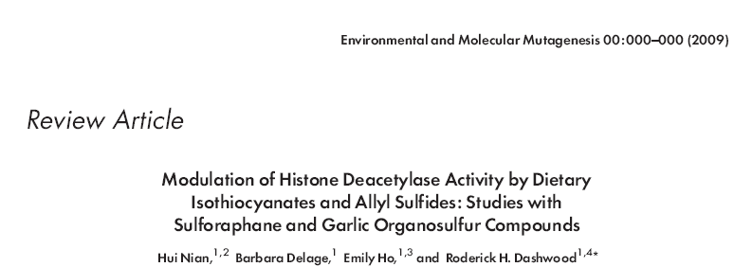
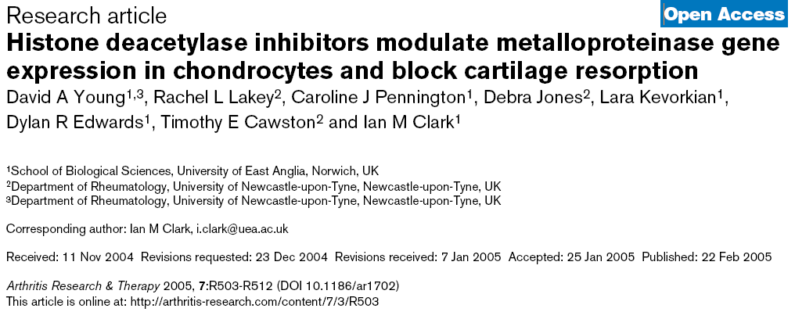
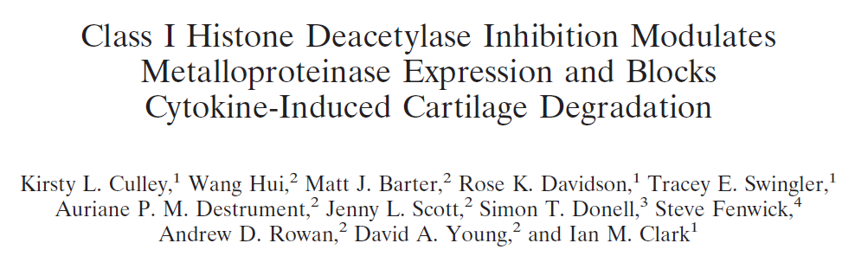

Notes:
Moreover, these organosulfur compounds are described as histone deacetylase inhbitors… and we have previously shown that such compounds block cartilage resorption

Slide 19

Sulforaphane
1-isothiocyanato-(4R)-(methylsulfinyl) butane
myrosinase
Plant injury
Pathogen attack
Chewing
Food prep
glucoraphanin
myrosinase
glucoraphanin
SFN

Slide 20
In man, 68g broccoli sprouts was sufficient to show HDACi in peripheral blood mononuclear cells (Myzack et al., 2007)

Slide 21

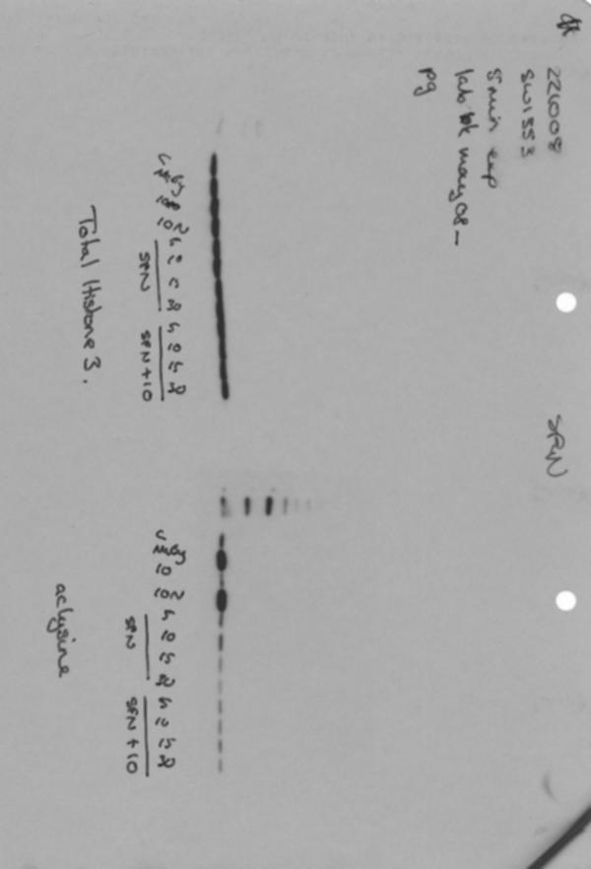

Histone acetylation
AcH3
No differences in:
Histone acetylation
Cytotoxicity
Apoptosis
Total H3
AcLys
TSA
5
10
15
30
5
10
15
30
SFN (μM)
Control
IL-1/OSM
IL-1/OSM/TSA
IL-1/OSM
SW1353 cell line
Notes:
Tubulin? HDAC6

Slide 22
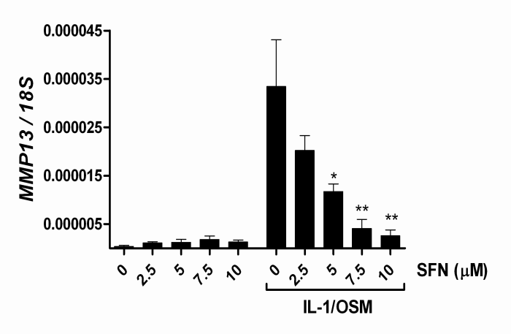
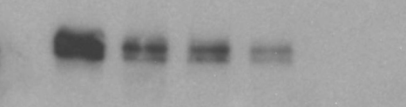
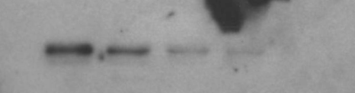
Chondroprotection in vitro
sulforaphane
46kDa MMP-1
43kDa MMP-13
SFN (µM) 0 5 10 15 30
IL-1/OSM + + + + +

Slide 23
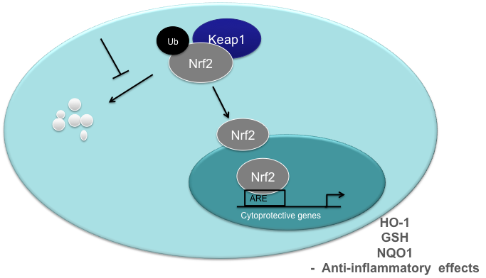
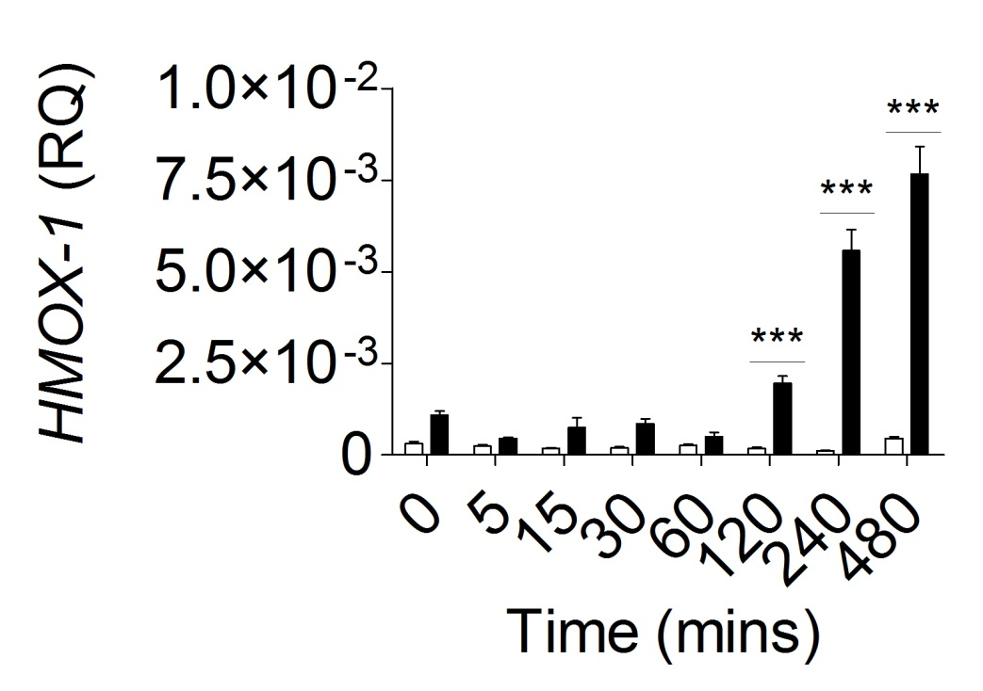
Mechanism?

Slide 24
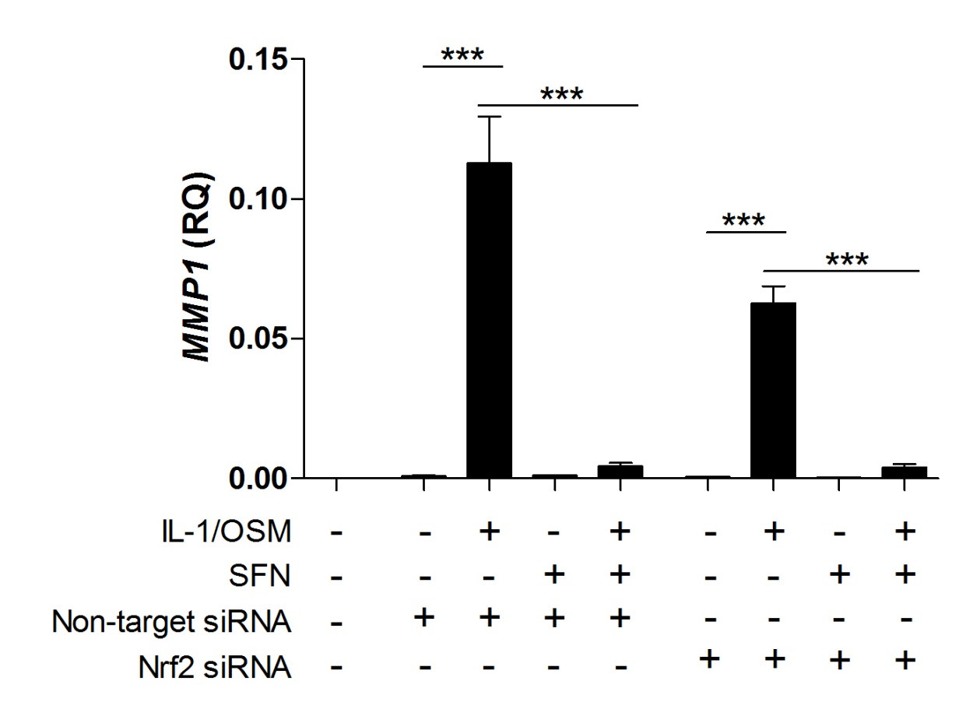
Deducing the pathways involved – Nrf2
SFN inhibits MMP expression independently of Nrf2
(cf HO-1 control)

Slide 25
Deducing the pathways involved – MAP kinases

Slide 26
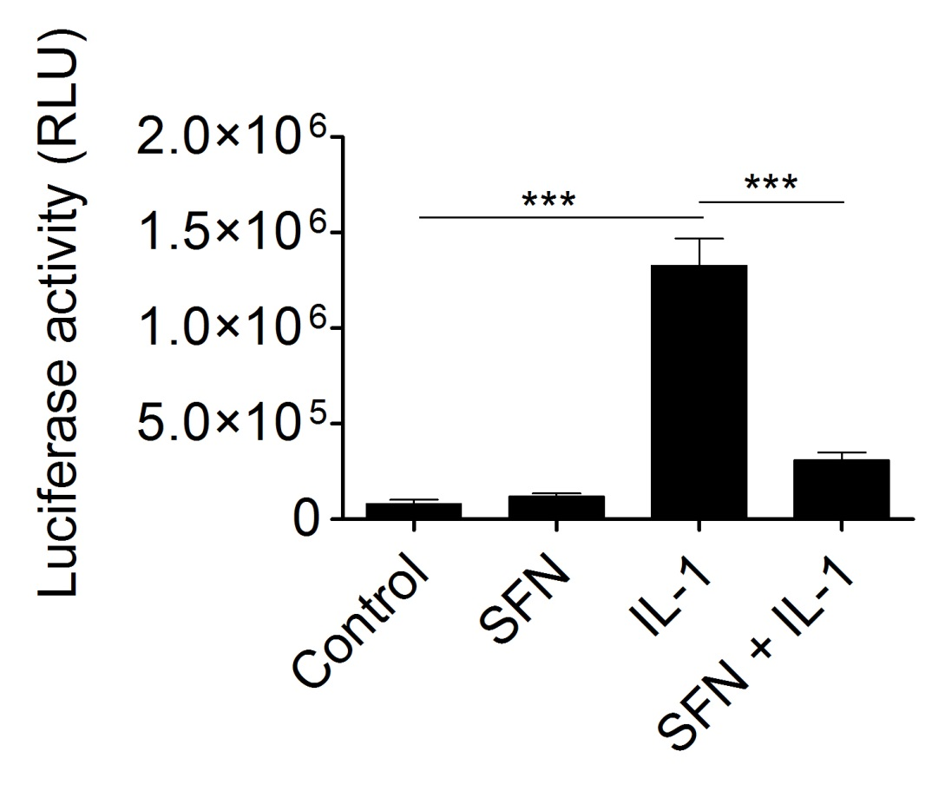
Deducing the pathways involved – NFκB
κB
κB
κB
κB
κB
Luciferase
IκBα promoter
Reporter

Slide 27
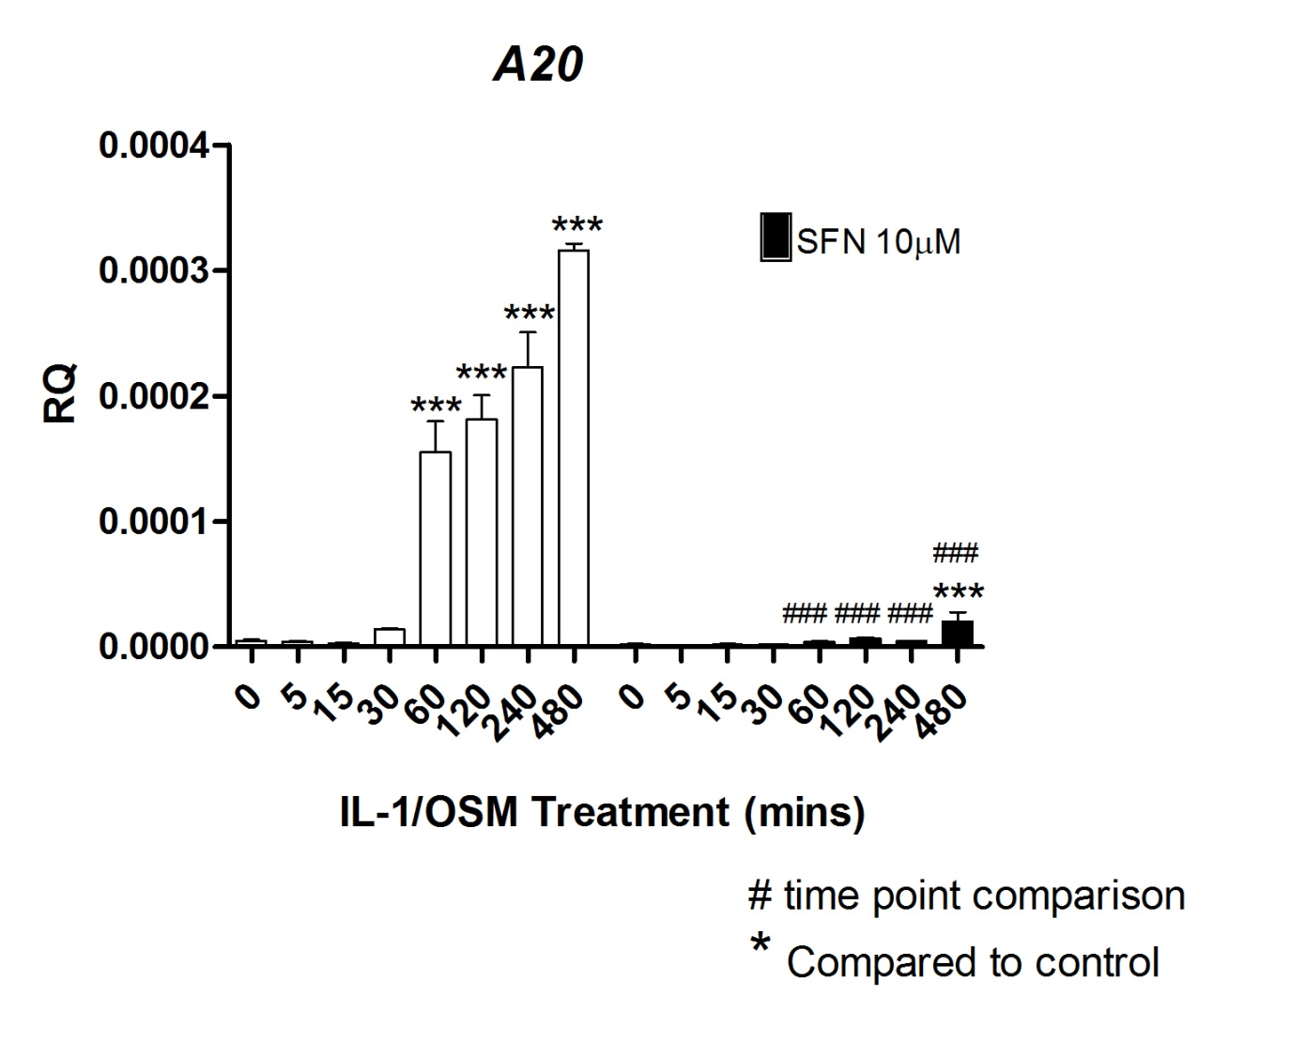
Deducing the pathways involved – NFκB
IL-6
IL-8
iNOS
SOD2

Slide 28
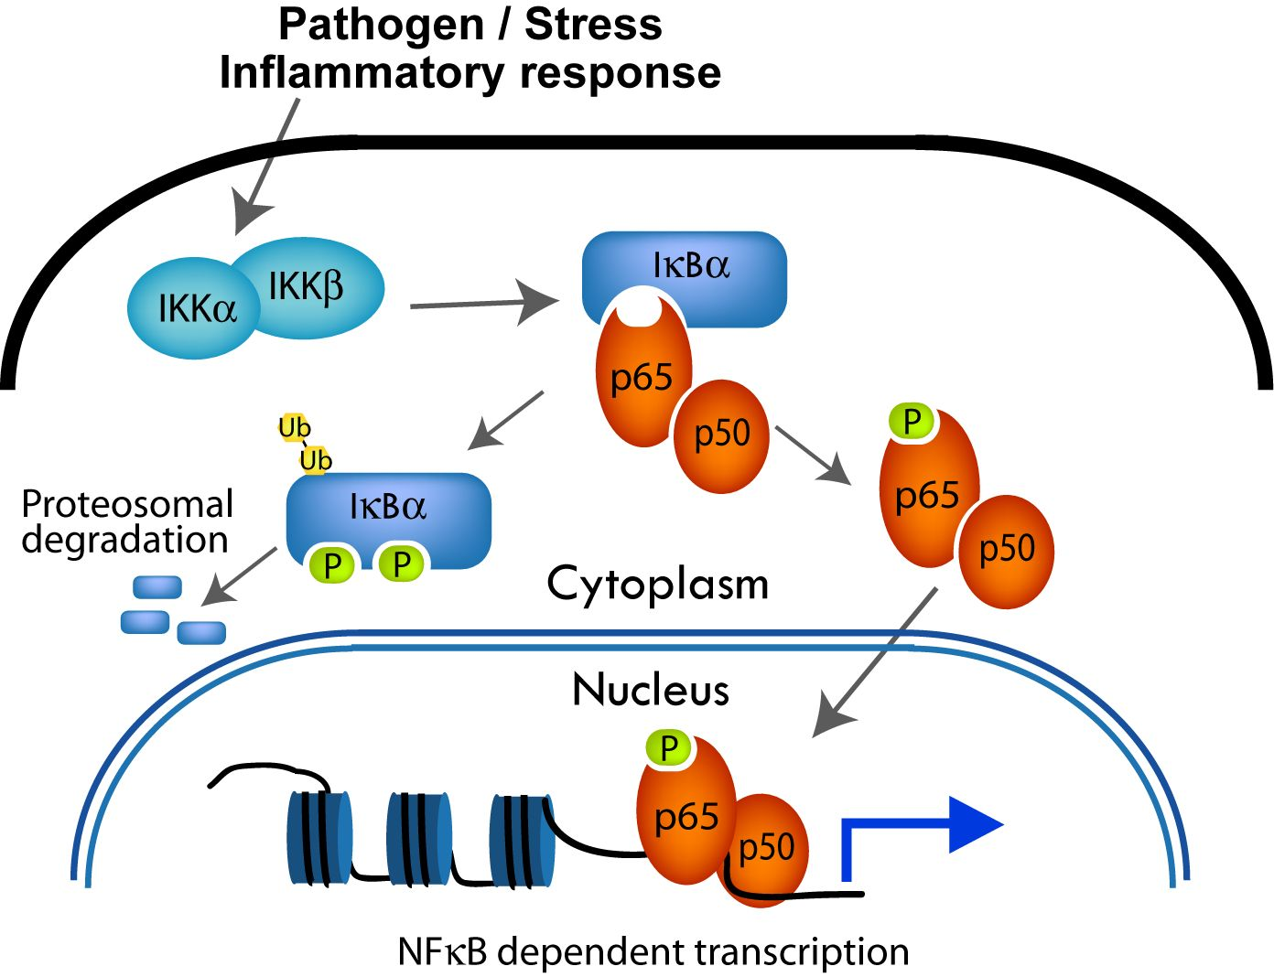
p65 phosphorylation and translocation

Slide 29
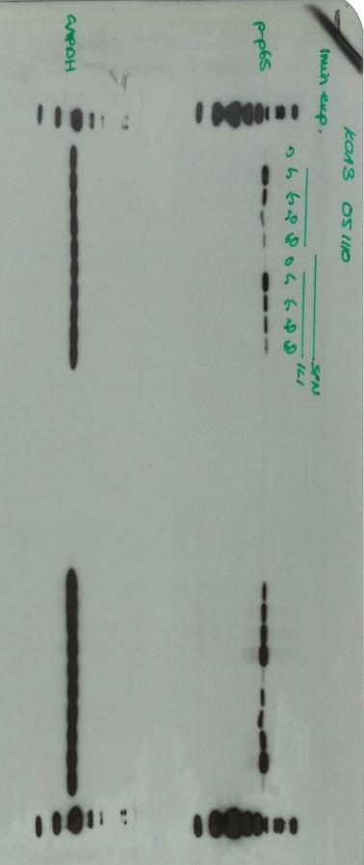
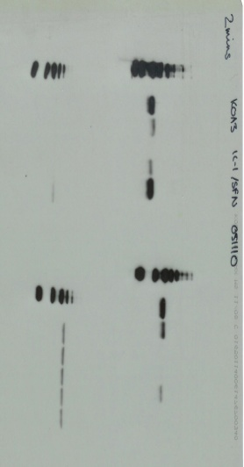
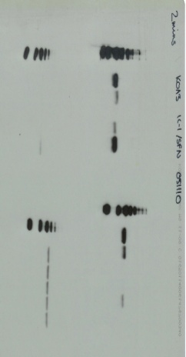
IκBα degradation and p65 phosphorylation
+ SFN
0
5
15
30
60
0
5
15
30
60
IL-1/OSM time (mins)
IκBα
phos-p65
GAPDH

Slide 30
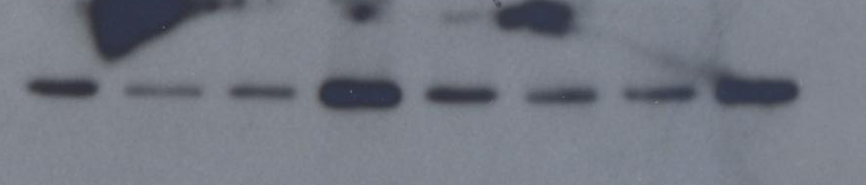
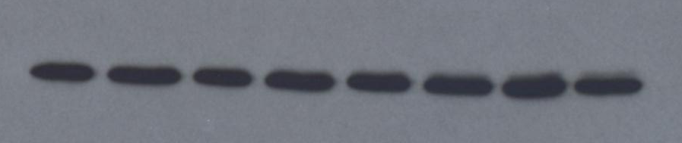
p65 translocation
p65
GAPDH
C
N
C
N
C
N
C
N
IL-1
SFN
SI
Control
C – cytoplasmic
N - nuclear

Slide 31
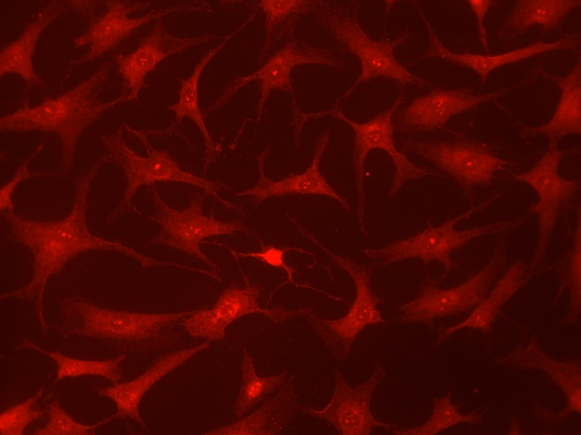

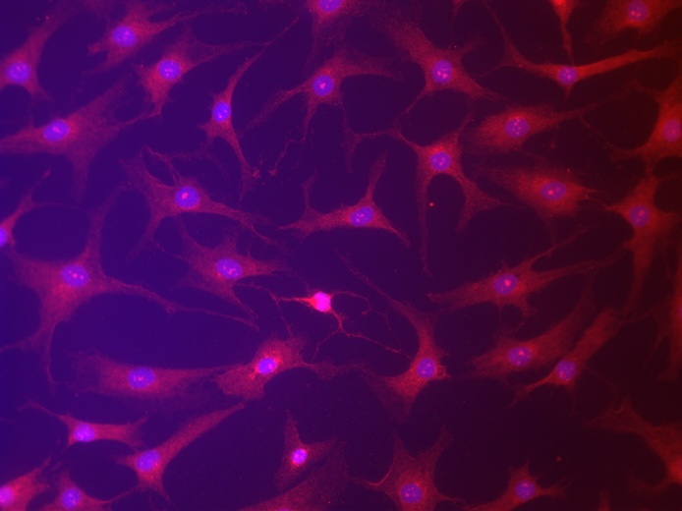
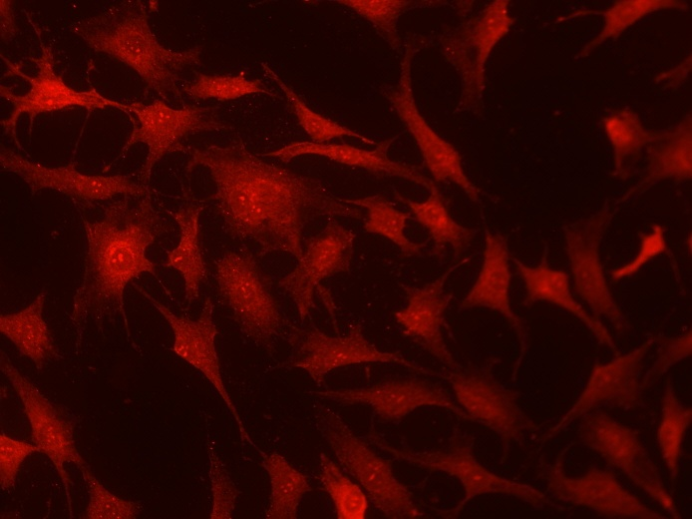
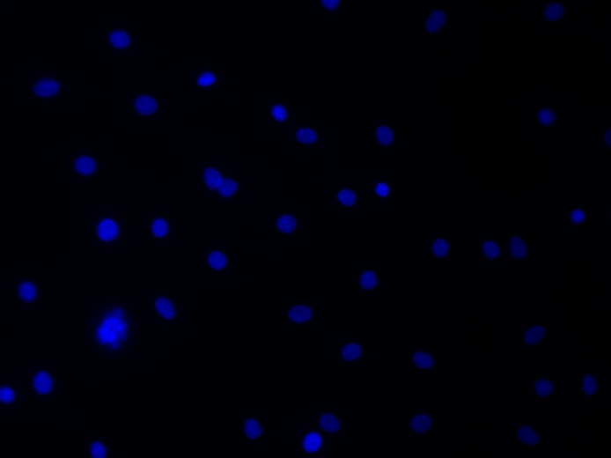
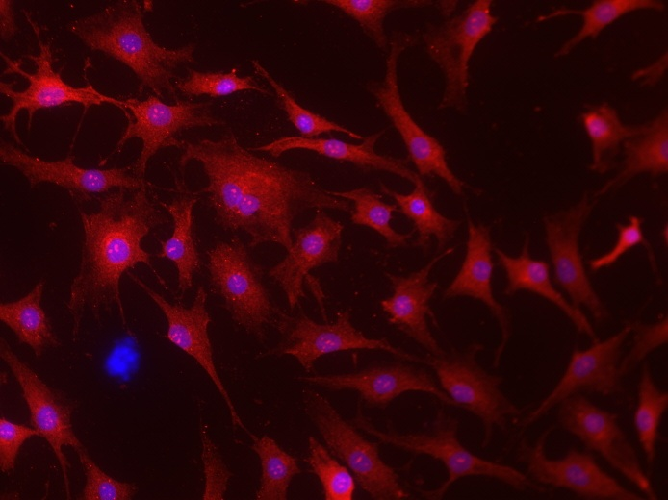
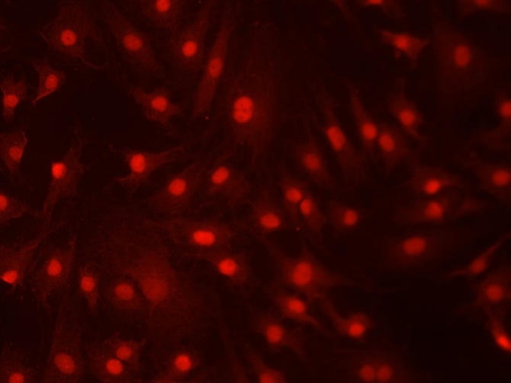

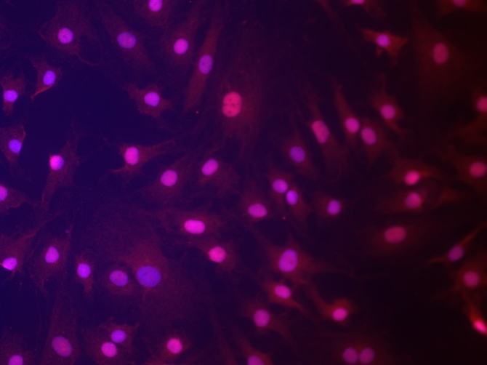
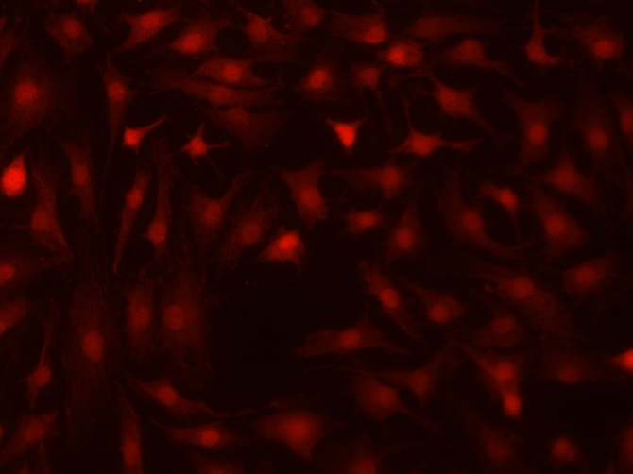
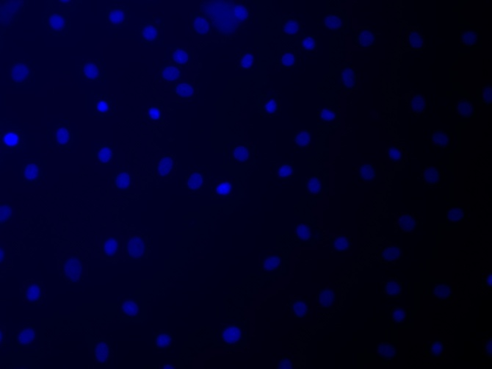
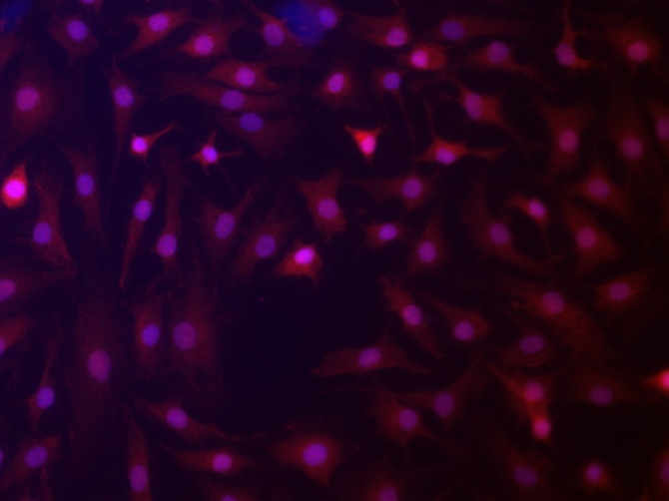
Dr Orla Jupp
p65 translocation
p65
DAPI
merge
Control
SFN 30min
IL1 45min
SFN 30min
+ IL1 45min

Slide 32
NF-κB DNA binding (EMSA)

Slide 33
Direct inhibition of NFκB binding
Dr Orla Jupp

Slide 34
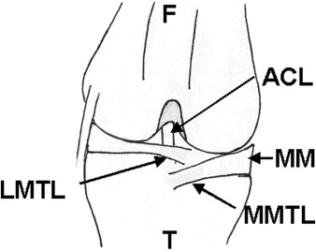
In vivo efficacy of sulforaphane
DMM (destabilisation of the medial meniscus) model of murine osteoarthritis
collaboration with Tonia Vincent, Kennedy Institute for Rheumatology
Glasson SS et al Osteoarthritis Cartilage. 2007 15(9):1061-9.
Arthritis Research UK Project: Dr Orla Jupp

Slide 35
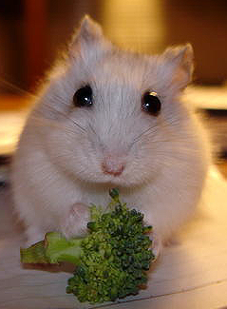
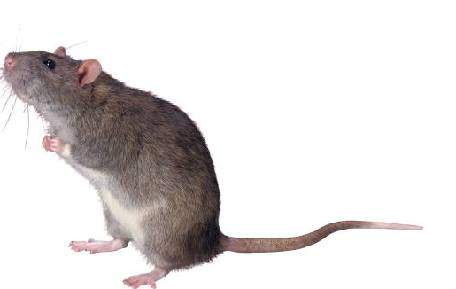
In vivo efficacy of sulforaphane
Low SFN chow
0.18mg/g chow
(1µmol/g)
Control Chow
12 mice in each group
x8 DMM
x4 Sham
Histology to score osteoarthritis in right hind knee joint
2. Collection of tissue (knee & serum) for LC-MS/MS
Tonia Vincent, Kennedy Institute for Rheumatology

Slide 36
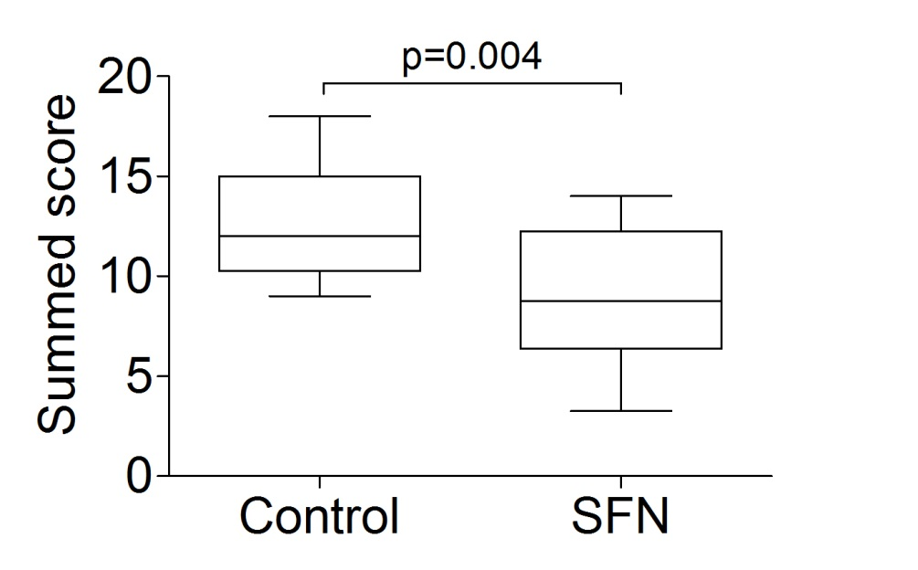
In vivo efficacy of sulforaphane

Slide 37
In vivo efficacy of sulforaphane
Gene expression
Injury induced genes
SFN inhibited genes

Slide 38
Summary
SFN (and DADS) is reported as an HDAC inhibitor
In chondrocytes, SFN can attenuate the expression of metalloproteinase genes in a dose-dependent manner
This is not through the inhibition of histone deacetylases and not via Nrf2 but most likely via inhibition of NFκB
SFN blocks cartilage destruction in vitro and in vivo

Slide 39
Where next?

Slide 40
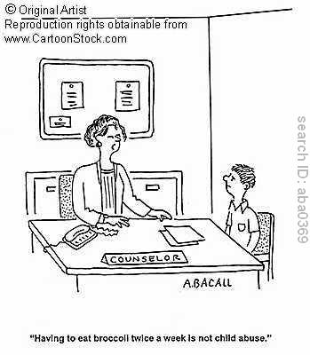
Proof-of-principle human study
“Having to eat broccoli twice a week is not child abuse”

Slide 41
Proof-of-principle human study
OA patients scheduled for TKR
40 patients
Low glucosinolate diet
20 patients
High glucosinolate diet
20 patients
1 Week washout
2 Week diet
Collect blood
Collect knee joint tissues
Analyse:
Gene expression
ITC tissue levels
In vitro degradation rates
Metabolomics.

Slide 42
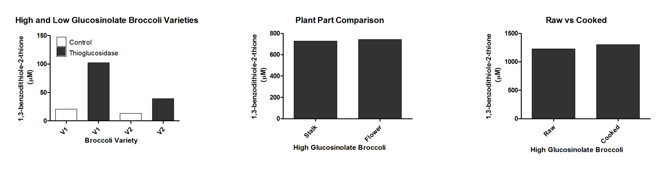
ITC content of broccoli intervention

Slide 43
Proof-of-principle human study
Patients consented 35
Patients completed 26
Patients not completed 2

Slide 44
Other dietary-derived isothiocyanates

Slide 45
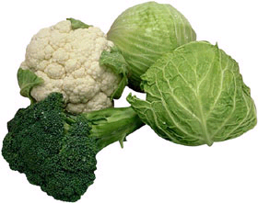
Isothiocyanate | Glucosinolate (precursor) | Food Sources
Allyl isothiocyanate (AITC) | Sinigrin | Broccoli, Brussel sprouts, Cabbage, Horseradish, Mustard
Benzyl isothiocyanate (BITC) | Glucotropaeolin | Cabbage, Garden cress
Phenethyl isothiocyanate (PEITC) | Gluconasturtiin | Watercress
Sulforaphane | Glucoraphanin | Broccoli, Brussel Sprouts, Cabbage
Iberin | Glucoiberin | Broccoli
Erucin | Glucoerucin | Rocket
Erysolin | Glucoerysolin | Broccoli, Rocket
Cruciferous vegetables contain a variety of glucosinolates, each of which forms a different isothiocyante when hydrolysed.
Dr Orla Jupp

Slide 46
Other isothiocyanates
0 1.25 2.5 5 10µM
Erysolin
SFN
Iberin
Erucin
BITC
AITC
PEITC
Dr Orla Jupp

Slide 47


The three most efficacious ITC’s do not display synergistic activity
SFN
IBR
ERY

Slide 48
Synergism with other compound classes…
Mr Jonathan Green

Slide 49
Summary
Other isothiocyanates can inhibit IL-1-induced MMP or ADAMTS expression with varying efficacy
A screen of dietary-derived compounds in both SW1353 chondrosarcoma cells and C28I/2 transformed chondrocytes uncovers compounds which alter MMP expression
A number of compounds have been analysed in primary human articular chondrocytes
Mechanism of selected compounds will be dissected in detail

Slide 50
Conclusion
Epidemiology shows a protective association between food groups and osteoarthritis
DADS and SFN are reported as HDAC inhibitors
In chondrocytes, SFN can attenuate the expression of metalloproteinase genes
This is not through the inhibition of histone deacetylases and not via Nrf2 but most likely via inhibition of NFκB
SFN blocks cartilage destruction in vitro and in vivo
Other ITCs show efficacy
Proof-of-concept human trial underway
Potential new diet-derived bioactives have been identifed and are being characterised

